Slide 1
USE OF DOD-APPROVED TELEHEALTH APPLICATIONS
POC: MAJ Jennifer Costello, DO
Jennifer.costello4.mil@mail.mil

Slide 2
Tele-Technology Work Group
MAJ Jennifer Costello
LT Maria Aguilar
Mrs. Barbara Leiner
Mr. Patrick DeLeon
Dr. Yolanda Brannon
Dr. Corinne Elmore
LT Thanh Nguyen

Slide 3

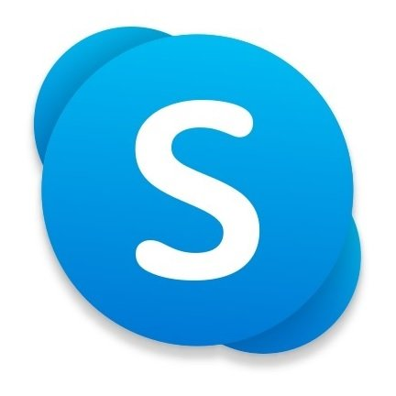




What is Approved?
Approved:
  Adobe Connect
  Cisco CMS
  FaceTime
  Skype
  GoogleDuo
  MS Teams
NOT Approved:
  Zoom
  Doximity Dialer
  EXPLICTLY NOT APPROVED

Slide 4






Features | Adobe Connect | Cisco CMS | FaceTime | Skype | GoogleDuo | MS Teams
Cellphone? | ✓ | ✓ | iPhone only | ✓ | ✓ | ✓
Personal Computer? | ✓ | ✓ | Mac Only | ✓ | ✓ | ✓
Govt. Computer? | ✓ | ✓ |  |  | ✓* | ✓
Audio Only Calls? | ✓ |  | ✓ | ✓ | ✓ | ✓
Hide Ph #? | ✓ | ✓ | ✓ | ✓ | ✓ | ✓
Screen Sharing? | ✓ | ✓ | ✓ | ✓ | ✓ | ✓
File Sharing? | ✓ |  |  |  | ✓ | ✓
Max Group Size | 100 | 25 | 32 | 50 | 32 | 100
* Duo works with Firefox on govt computers

Slide 5
ADOBE CONNECT
1.) Per DHA, to request an Adobe Connect Account visit: https://info.health.mil/army/VMC/Pages/Home.aspx
-Click on Adobe Connect on the Left Hand Side
-Then click on ‘Adobe Connect Request’
2.) Once you have your account and are ready to see patients you can create a new meeting
-Input the correct session date and time
3.) All users need to download the AC app if using a phone.
4.) All users need an updated version of Adobe Flash Player if using a computer.
***Audio Lag can be significant with this program – consider using simultaneous phone call to prevent audio lag.***

Slide 6
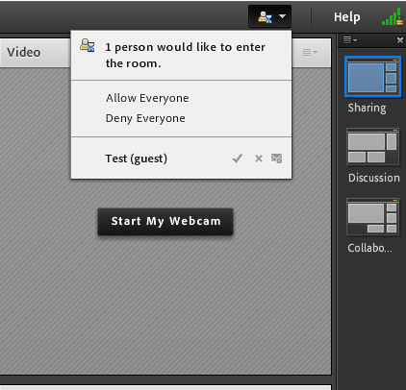

ADOBE CONNECT
HOW TO USE
  Step 1: Select 1 of 3 virtual room formats by clicking on the desired layout image or by using the “Layout” tab.
    1.) Sharing
    2.) Discussion
    3.) Collaboration
  Step 2: The meeting host (or provider) must
  open the virtual meeting room.
  Select the “ “ symbol by the guest or
  patient’s name to grant access.
  After access is granted, the name will appear as a participant in Adobe Connect.
  Additional access and entry features can be selected through the “meeting” tab.
Step 1
Step 2

Slide 7
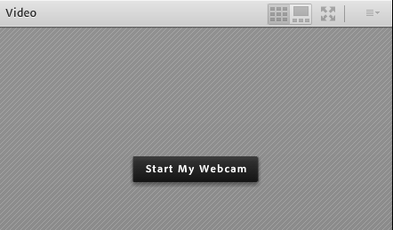
ADOBE CONNECT
Step 3: Turn on your speaker, audio, and webcam.
Click on each icon to turn on these features. The icons will appear white when turned off.
The icons will change color when turned on. After turning on your webcam, select “Start Sharing” in the webcam box.
The webcam can also be turned on directly from the webcam box.

Slide 8
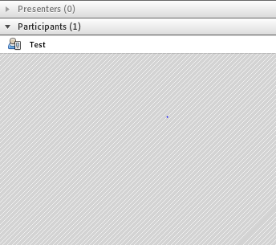
ADOBE CONNECT
  Step 4: Turn on permissions for the participant (or patient).
  Place the cursor over the participant’s name.
  Several permissions will appear in the box:
    Start private chat allows for chatting with a
    participant or other group member.
    Enable microphone allows for audio usage.
    Enable drawing allows host and participant to
    draw or type on screenings or handouts.
    Request screen share allows the participant to share his/her screen.
    Make host. Use when there is a role change.
    Make presenter. Use when there is a role change.
Step 4
Start private chat
Enable microphone
Enable drawing
Request screen share
----------------------------
Make host
Make presenter

Slide 9
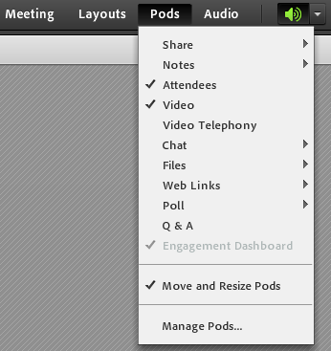

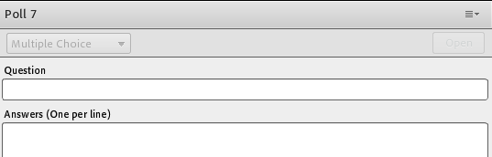
ADOBE CONNECT
HOW TO CREATE POLLS IN ADOBE CONNECCT
Create multiple choice questions or short answer polls for a participant or group member by clicking on “Pods.” Scroll down to “poll” and follow steps below:
Step 1
Show as %
Show as numbers
Show both
Hide
Maximize
Broadcast Results
Clear Answers
New Poll
Select Poll
Select Question Type
Open
Help
Step 5
Step 2
Step 4
Step 3
Multiple Choice
Multiple Answers
Short Answer

Slide 10

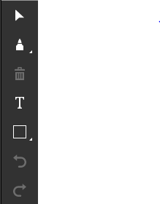

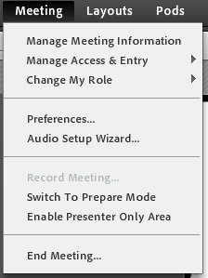
HOW TO USE ADOBE CONNECT
DRAWING TOOLS ON LAPTOP
  HOW TO USE ADOBE CONNECT DRAWING TOOLS
  Click on the “Share My Screen” down arrow in the center of
  the Adobe screen. Scroll down to “Share Document.” Upload
  documents prior to entering the virtual room via the “content”
  tab or through “Share My Screen.”
  Once the document opens on the virtual screen, click on “draw.”
  The drawing tools will appear on the screen for the host and
  participant.
  HOW TO END MEETING
  Select “meeting” tab
  and scroll down to
  “End Meeting.”
Drawing Tools

Slide 11
CISCO CMS
Web-based platform approved by DHA/DoD for patient encounters & groups, widely used at other MTFs.
  Patients and providers do not need to download an additional app.
  The meeting is accessible via approved web browsers listed below.
  Works with and without VPN.
CMS meeting can be accessed through any of the following web browsers:
  Chrome
  Firefox
  Windows Edge
  Chrome in Android devices
  Safari in Apple devices
  *CMS cannot be accessed through Internet Explorer.*

Slide 12
CISCO CMS
Pros:
  HIPAA compliant, approved by both DoD and DHA
  Meetings can hold a max of 25 participants
  Can screen share
  Meetings (patient encounter) only open for the dedicated time allotted
    Patients cannot log into the virtual space outside of scheduled times and do not see your email or phone # if you send the link through Secure Messaging
Cons:
  No dial-in line, i.e. no audio only
  No chat feature
  Cannot upload documents
  Need to be given account to schedule a meeting
    Whether providers or administrators schedule patient meetings (encounters) will depend on local policy

Slide 13
CISCO CMS
To Become a Scheduler (Not necessary for providers if administrators schedule patient encounters):
  Getting an account: Staff who need to schedule teleconferences can request CMS Smart Scheduler accounts at no cost by sending an email to melissa.ford7.civ@mail.mil . These accounts need to be used at least monthly in order to remain active
  Requesting training: Available on request through melissa.ford7.civ@mail.mil or harold.c.arens.civ@mail.mil
  Email Ms. Toni Shivers (toni.t.shivers.ctr@mail.mil) for CMS SOP v5 for additional instructions on being a scheduler
    For those who become schedulers:
      The first five numbers of the video address is your “Meeting ID”
      The meeting PIN is the “Passcode”

Slide 14
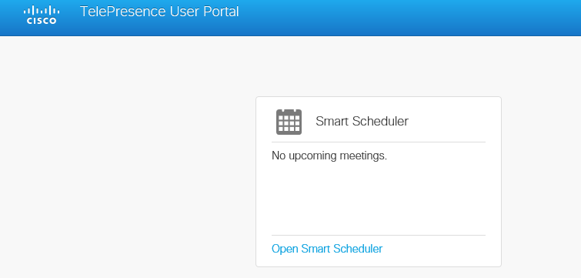
CISCO CMS
How to schedule meetings:
  If you already have an account, you can access CMS at https://ipvs.meet.health.mil using Firefox, Chrome, Safari, or Microsoft Edge, but not Microsoft Internet Explorer
  Log in with your CA-51 certificate. You will be prompted for your PIN after you select your certificate.
  You will immediately be directed to the home screen of user portal
  To schedule a meeting you will click on Open Smart Scheduler

Slide 15
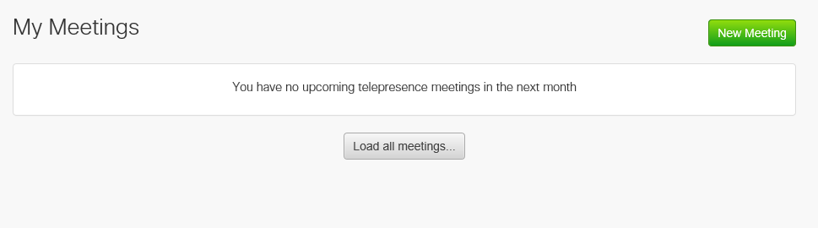
CISCO CMS
To schedule a conference:
  Click on New Meeting

Slide 16
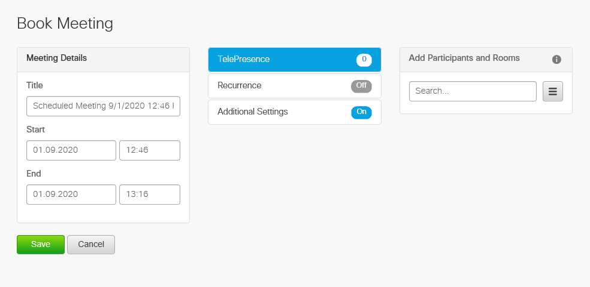
CISCO CMS
To schedule a conference:
  The next screen will allow you to title your meeting, select the start and end time, add participants, choose how often you would like for this meeting to occur, and choose additional settings.

Slide 17
CISCO CMS
Meeting Options:
  The telepresence allows you to add the number of participants you expect to join your meeting.
  Allowance of more than 25 simultaneous participants in one virtual conference must be requested by contacting Chris Arens, harold.c.arens.civ@mail.mil.

Slide 18
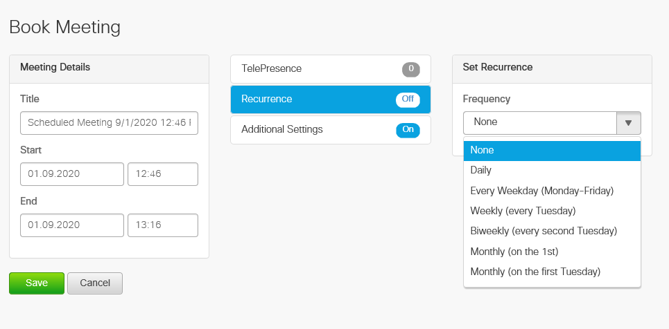
CISCO CMS
Meeting Options:
  The recurrence option allows you to schedule recurring meetings.
  Please note, the scheduler supports recurrence variations of daily, all weekdays, weekly, biweekly, and monthly. In order to schedule a recurring meeting for alternate days of the week, or multiple times in the same day, you will need to schedule each meeting as a recurring weekly meeting.

Slide 19
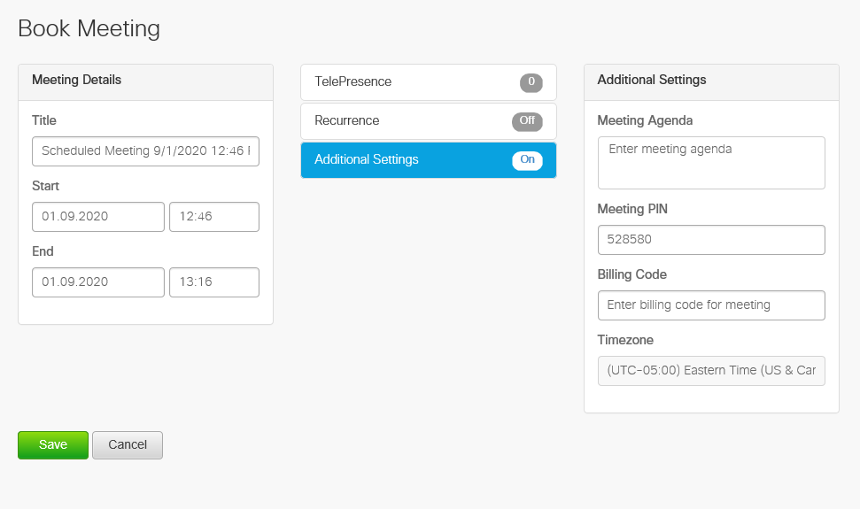
CISCO CMS
Meeting Options:
  The additional settings option allows you to optionally set the meetings agenda, meeting PIN, billing code, and/or time zone for the meeting.

Slide 20
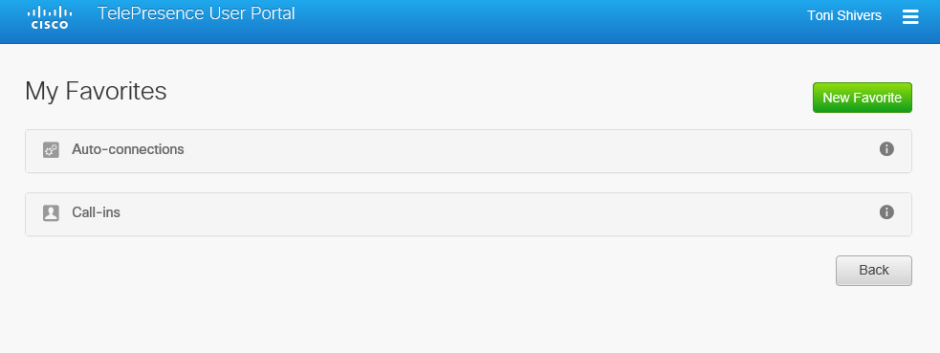
CISCO CMS
Meeting Options:
  By selecting the three lines in the right hand corner, you can access your favorites.
  This option allows for access to frequently used dial in information, for example.

Slide 21
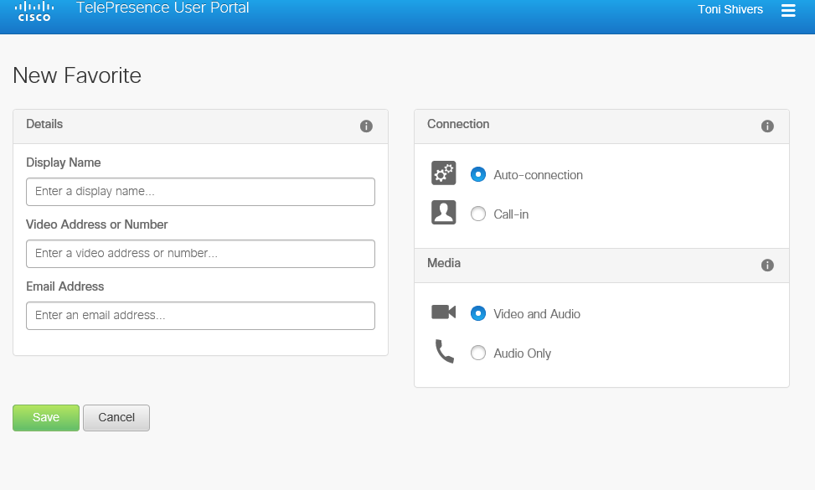
CISCO CMS
Meeting Options:
  By selecting “new favorite” you will be able to fill in details about the display name, number, email address and how you attend the meeting.

Slide 22
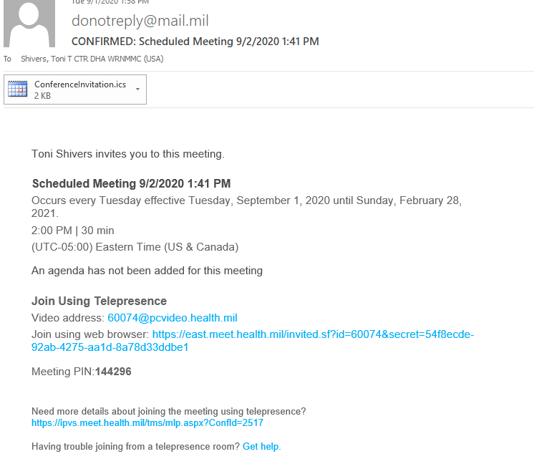
CISCO CMS
After scheduling your meeting you will receive an email including the details you selected.

Slide 23
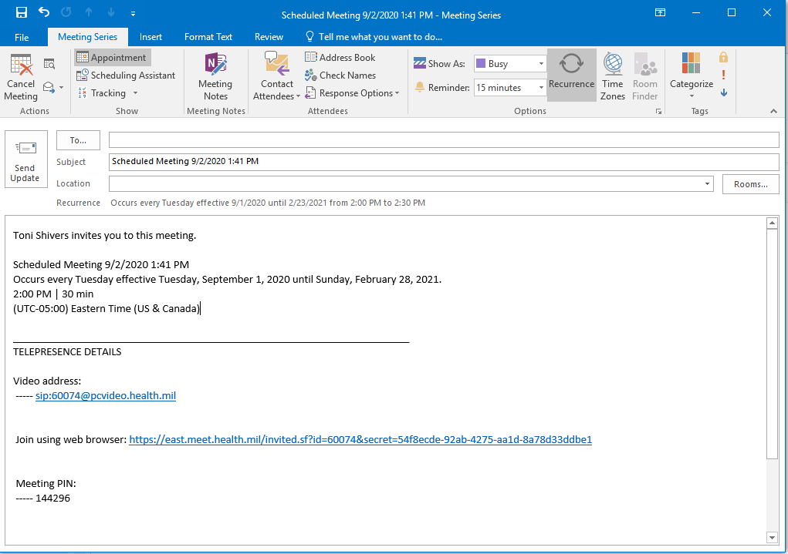
CISCO CMS
By clicking on the attached .ics file you will be able to add the appointment to your personal Outlook calendar where you can add the attendee(s) by email addressee(s), and customize the subject line and content of the invitation.

Slide 24
CISCO CMS
**NOTE: You will not be able to select the “video address” ("sip”) address unless you are using VTC equipment, such as the Polycom devices found in some conference rooms. You may want to delete this option from your email invitation if you do not expect it to be used.

Slide 25
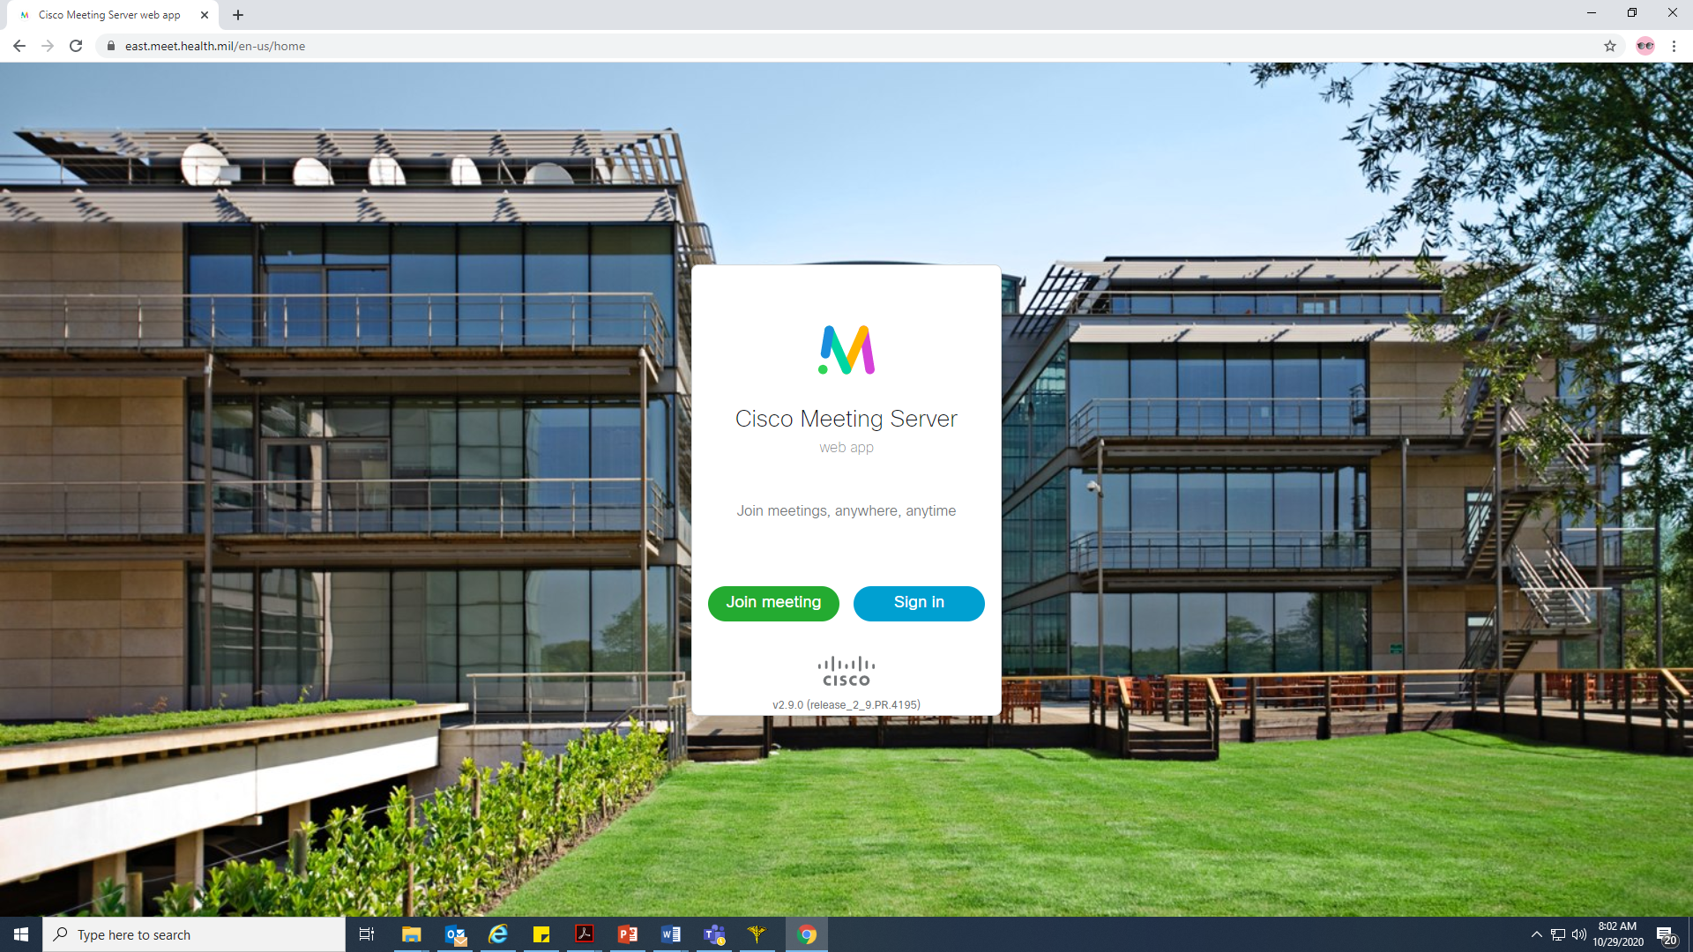
Cisco Meeting Server (CMS)
To Use:
  You will either receive your meeting link via CMS or from your scheduler.
  Enter the link into the web browser (Google Chrome or Firefox if you are using a government computer).
  You will be taken to the site below; click the green “Join Meeting” button.

Slide 26
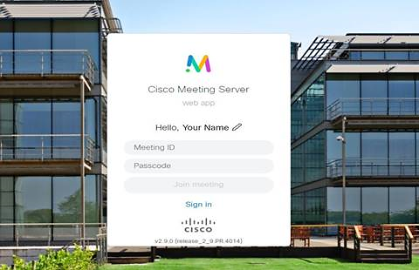
Cisco Meeting Server (CMS)
To Use:
  After clicking "Join Meeting," you will be taken to the login screen:
    Click the pencil icon (indicated by the blue arrow) to edit “Your Name" so people will recognize you in the meeting
      Enter your name.
    Enter the Meeting ID and Passcode (meeting PIN) and click “Join Meeting”.

Slide 27
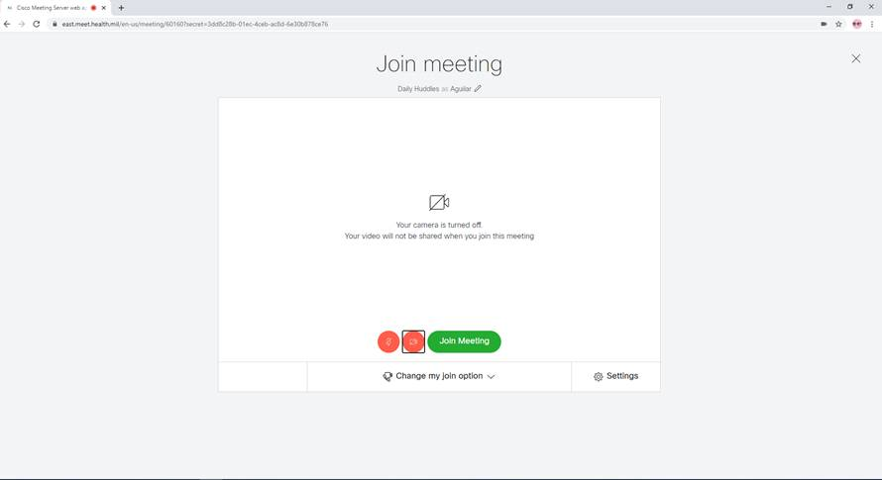
Cisco Meeting Server (CMS)
To Use:
  Prior to entering the meeting, you will see the following screen.
  There are two icons next to the green “Join Meeting” button that represent your microphone and camera. If these are RED, they are turned off. They will turn gray when you click on them to turn them on.
  Click the green “Join Meeting” button.

Slide 28
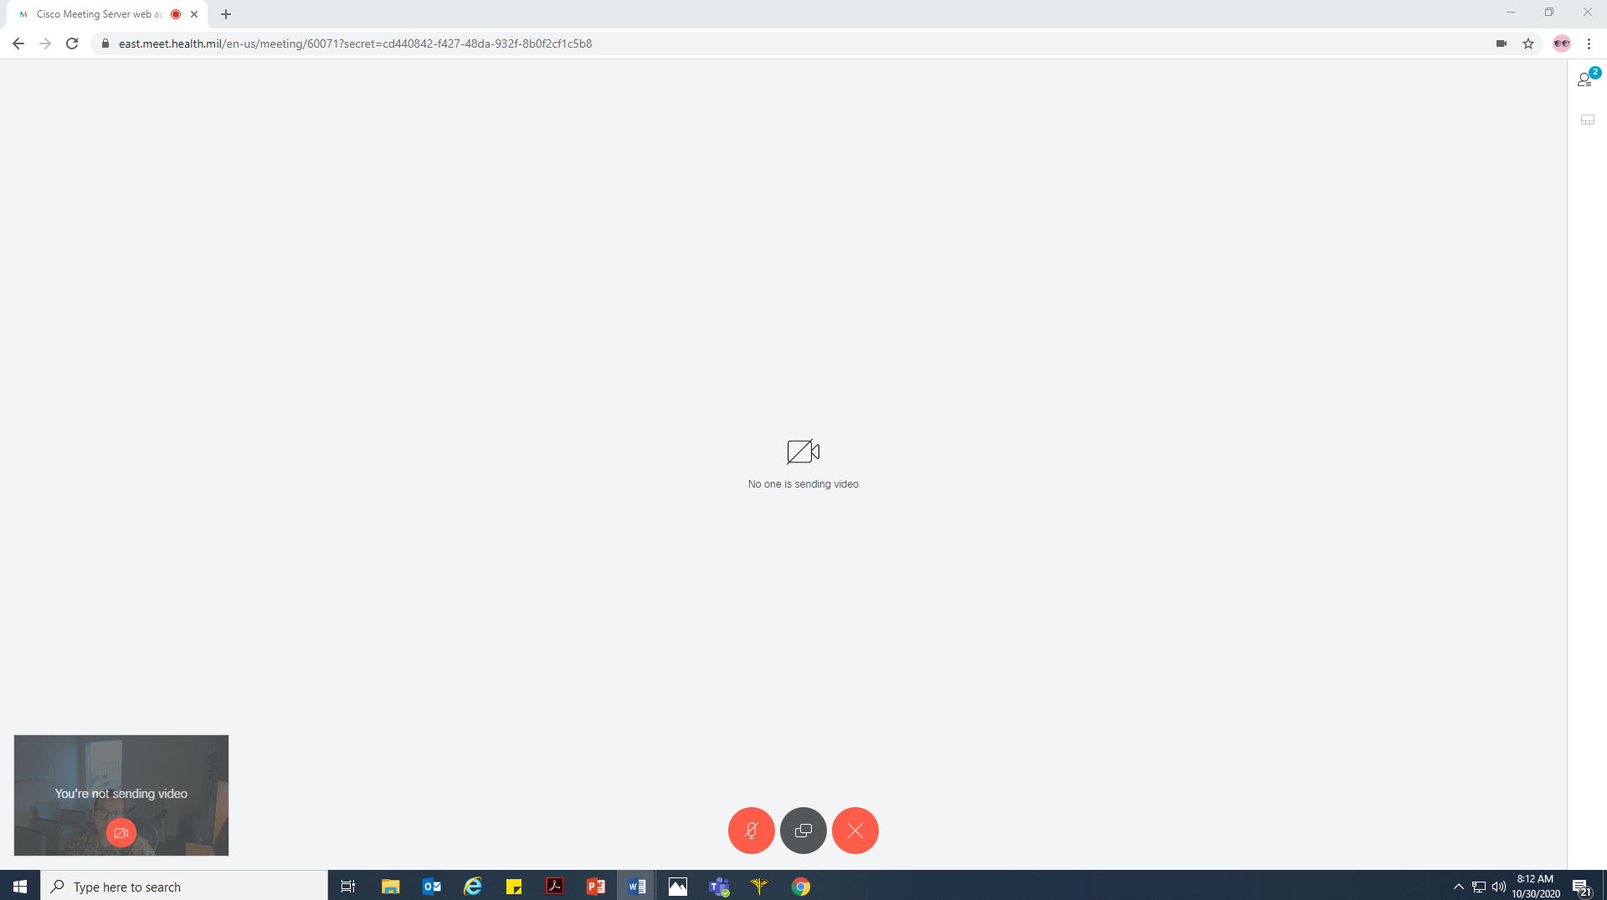
Cisco Meeting Server (CMS)
To Use:
  Once in the meeting, you will see the following screen.
List of Participants
Screen View
Your video feed. This box will go away if you stop moving your mouse. Red camera icon indicates that your camera is “Off”. Click on the red camera icon and it will turn gray and your camera will be “on”.
Share Screen Icon: Click on this icon to share your screen.
Microphone Icon: If is Red, then your microphone is “Off”. Click on the icon to turn on your microphone. It will turn gray.
Exit Meeting

Slide 29
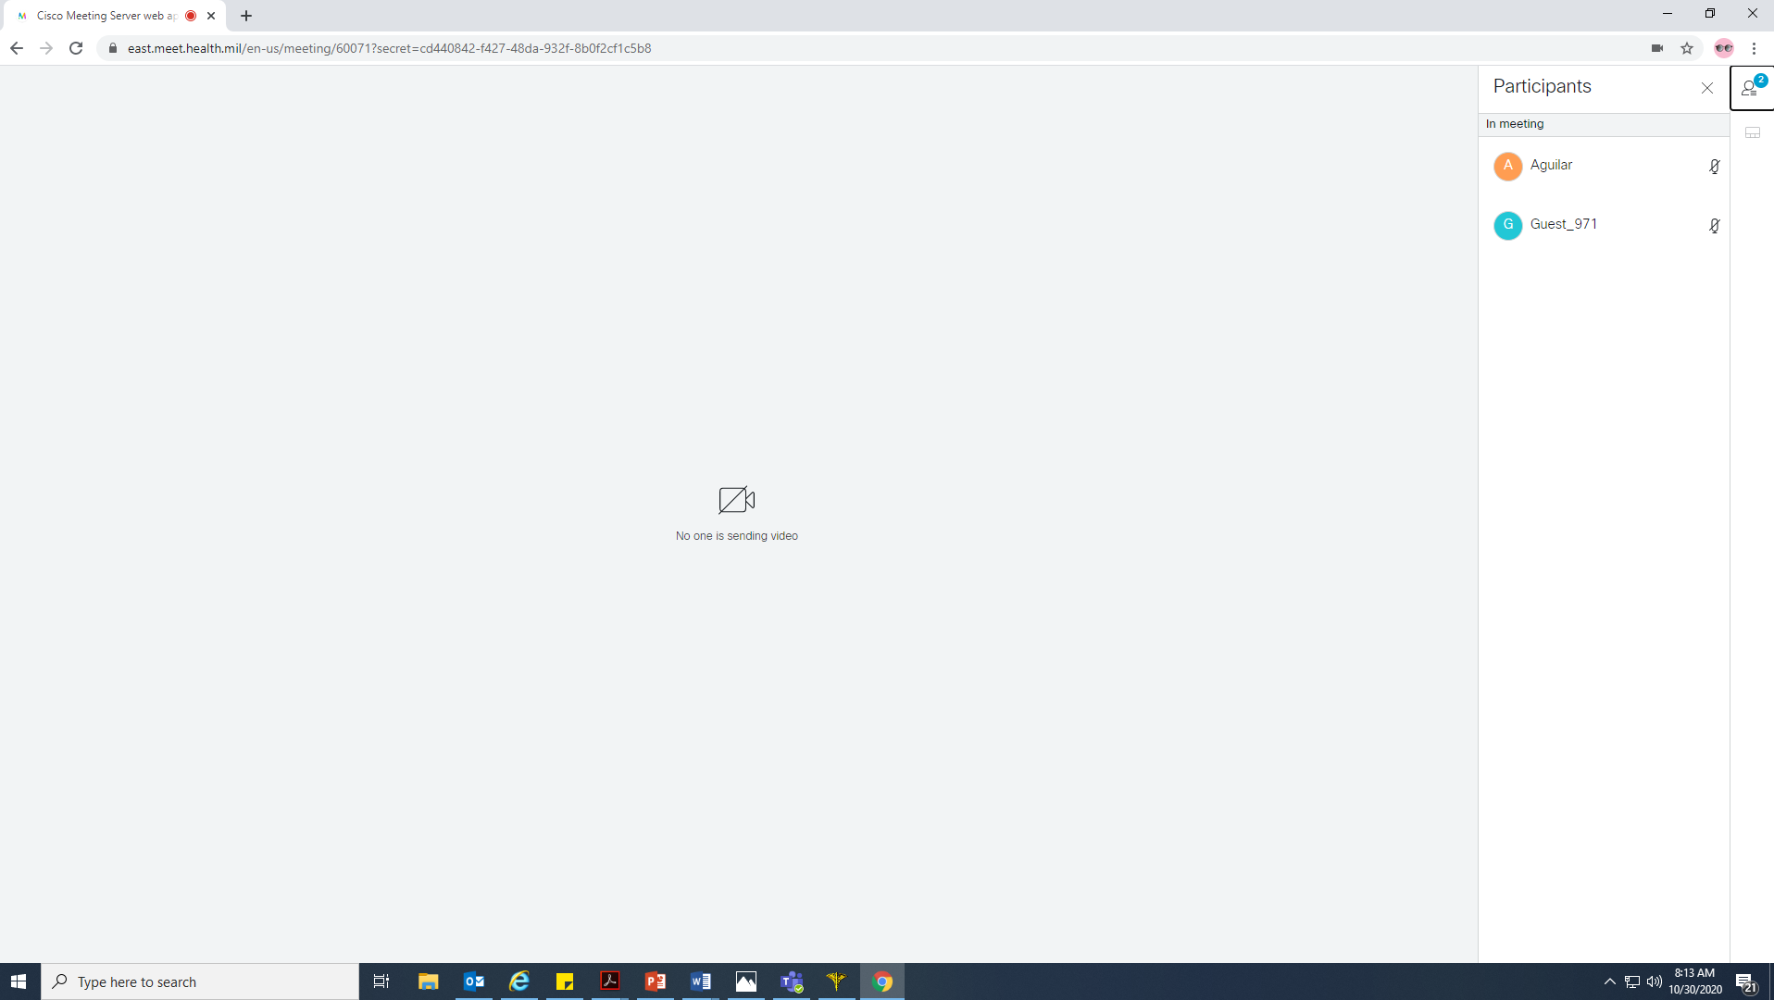
Cisco Meeting Server (CMS)
To see Participants:
  When you click list of participants, you will see the following screen.
List of Participants

Slide 30
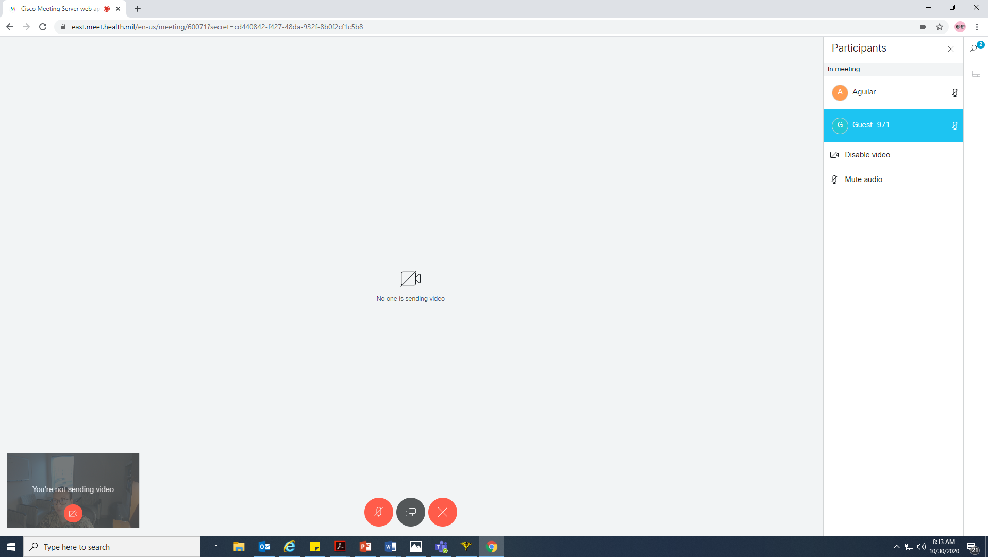
Cisco Meeting Server (CMS)
Disable video and mute other participants:
  If you click on another participant's name, you will see the option to disable their video or mute their audio.
List of Participants

Slide 31
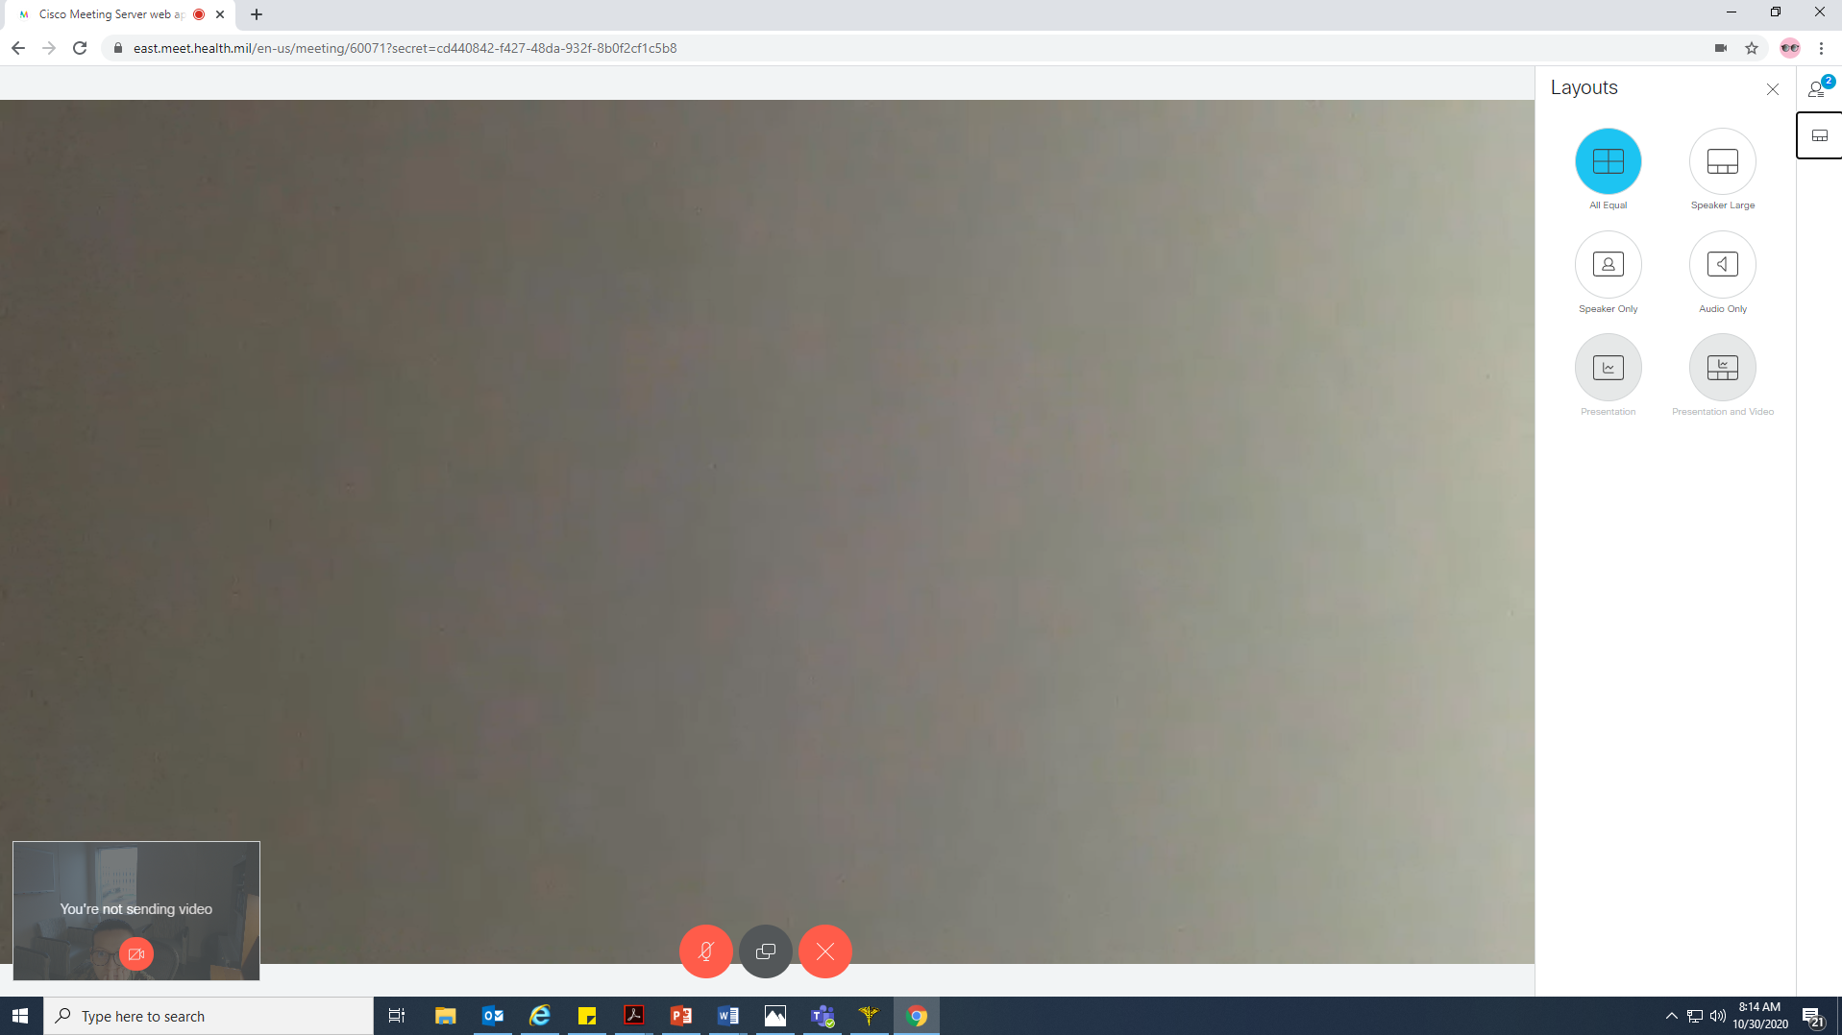
Cisco Meeting Server (CMS)
Screen View:
  When you click on Screen View icon, you will see the following screen.
  This allows you to change the view of the group.
Screen Layouts

Slide 32
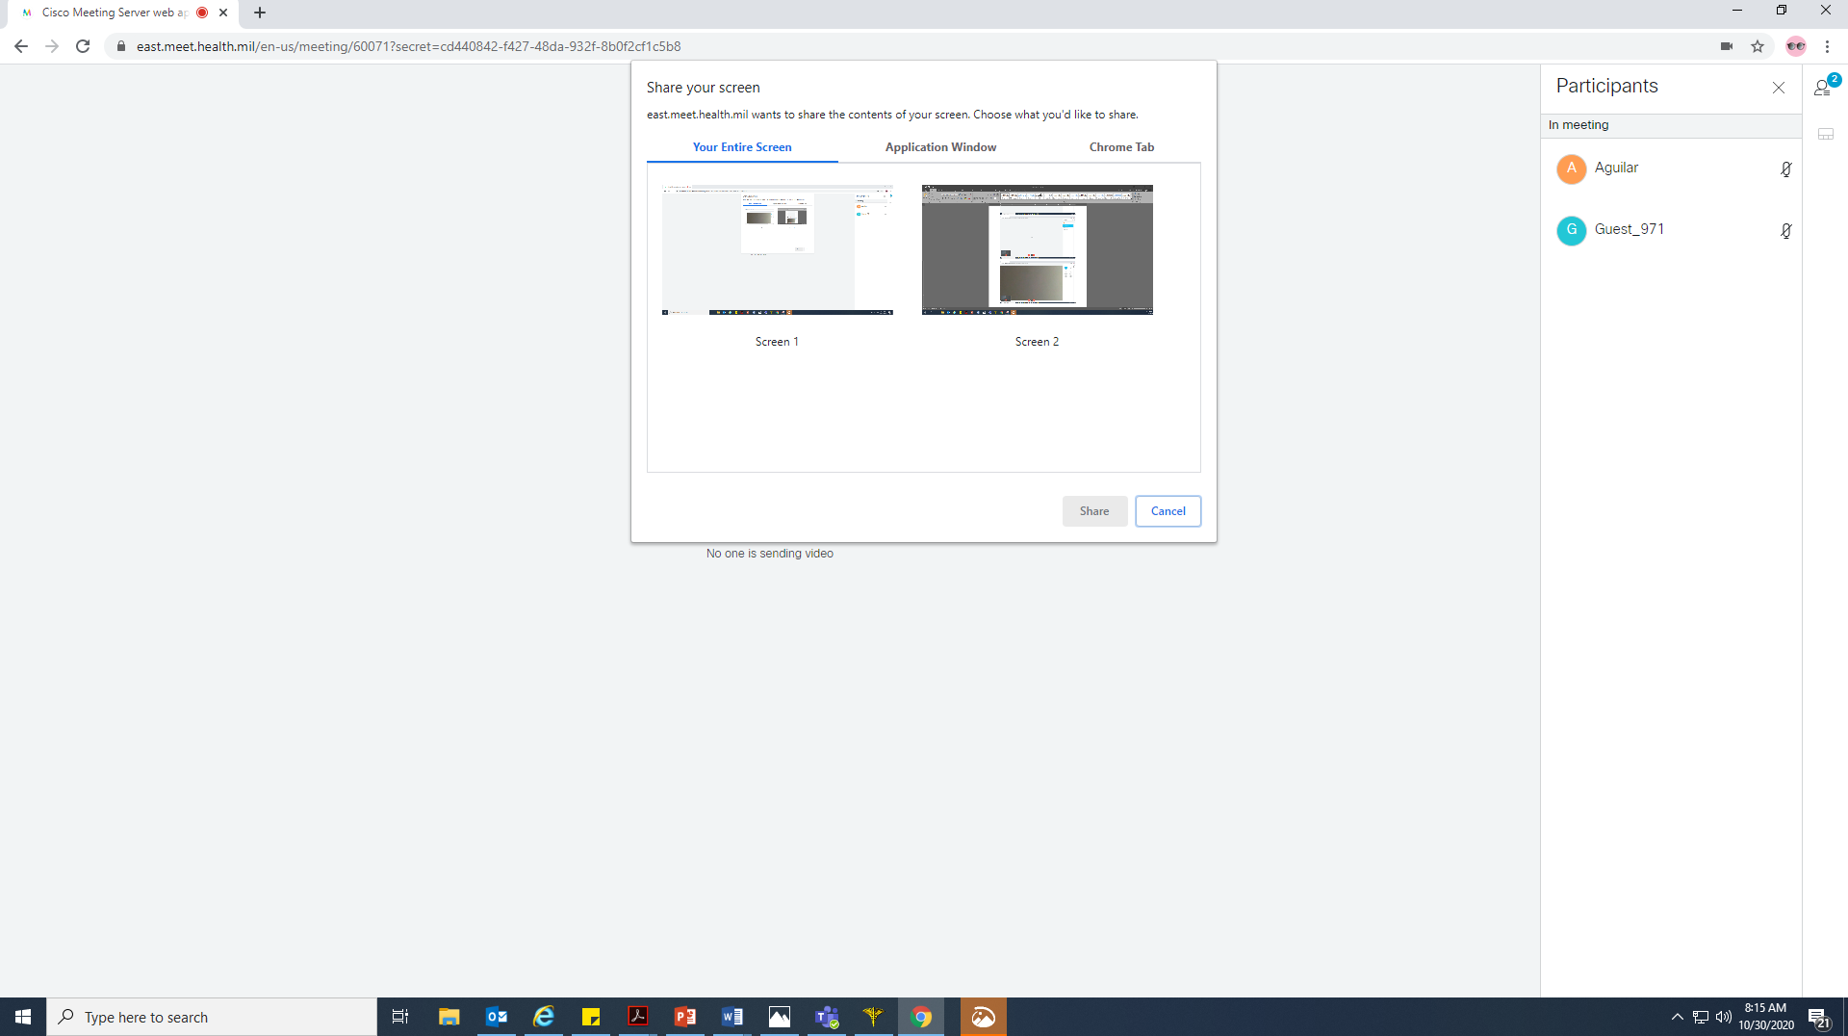
Cisco Meeting Server (CMS)
Screen Sharing:
  When you click on the Screen Share icon you will see the screen below
  You may share either:
    Your entire screen
    Application window (will show whichever applications you have open).
    Chrome tab (or whichever web browser you are using)

Slide 33
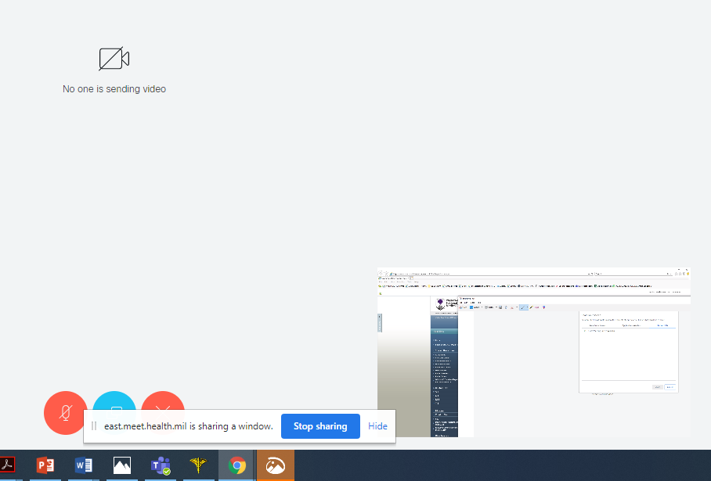
Cisco Meeting Server (CMS)
Screen Sharing (cont):
  Once you select what you would like to share, you will see the screen below
  Note the pop-up informs you that you are sharing and blue “Stop Sharing” button. Click on “Stop Sharing” to stop screen share.
  You will also note that the Screen Share icon is highlighted blue (indicated by green arrow). Click on the icon to stop screen share.
  You can see the small screen you are sharing, outlined by the green box.

Slide 34
FACETIME
Call the patient’s number directly at the time of the appointment
  Must ensure patient has Apple Product
Only works on Apple products (IPhone or MacBooks)
FaceTime allows user to display email address instead of number
To share screen using FaceTime have to simultaneously open and use Apple Messages app
When you dial a patient’s contact info, you will always have the option with either program to either do a voice only call, or a video call
  While clinical encounters are video based, if you need to quickly reach a patient to change an appointment time, or otherwise initiate a brief call, you can conveniently use either program for voice only.

Slide 35
FACETIME
You can set preferences so only your professional contact information as caller ID visible to the patient. On your Mac:
  Open FaceTime, go to menu bar at top, select FaceTime, then Preferences
  Under Settings, see You can be reached for Facetime at:
  Enter your military email address and select it, deselect your personal contact information
  When you FaceTime a patient, your work email will be caller ID, this is also how the patient can initiate a video call to you.
  Note that if you put the curser in your video picture during a call, you can change the orientation (see the curved arrow), also you can change the placement of your video to a different corner of the screen

Slide 36
FACETIME
You can set preferences so only your professional contact information as caller ID visible to the patient. On your iPhone:
  Go to Settings
  Scroll down to FaceTime and select
  See “you can be reached at,” this should include your military email as well as your personal contact information
  Scroll down one section to Caller ID
  Select your military email as caller ID, this is what patients will see

Slide 37

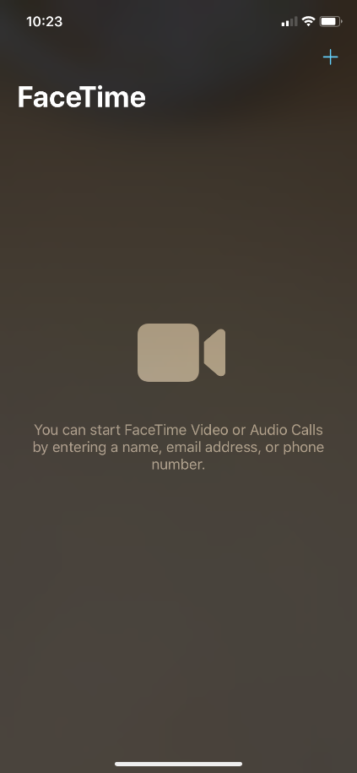
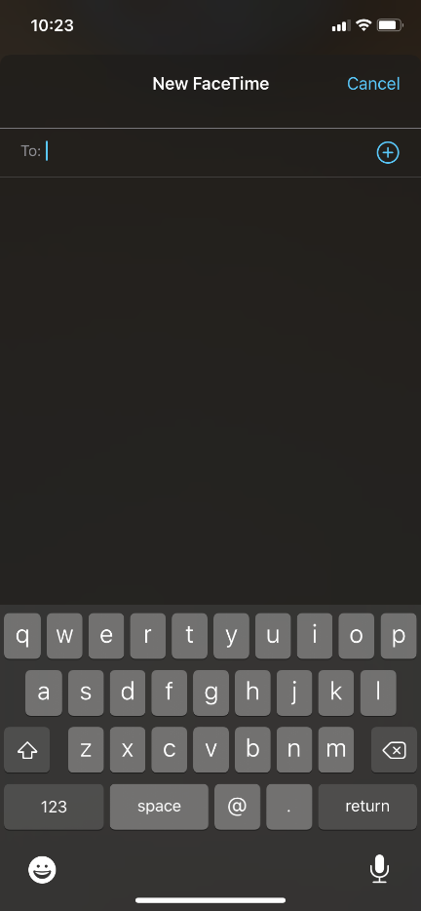
FACETIME
1.)
HOW TO USE:
1.) Click the FaceTime App picture
2.) When you see the screen in #2 press the “+” sign
3.) Enter the phone number of the patient – may need to press the ‘123’ button to get to the numbers
2.)
3.)

Slide 38
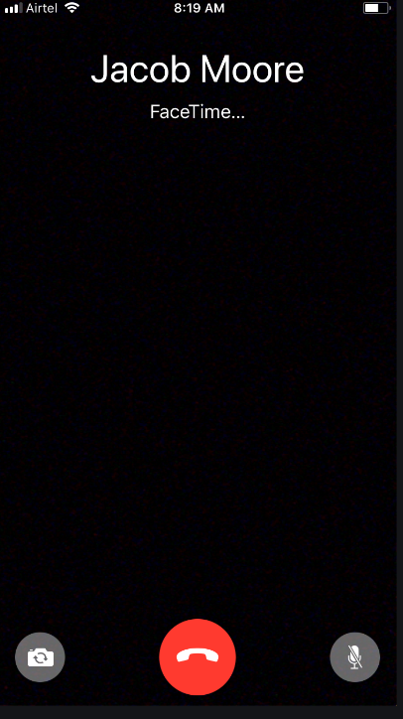
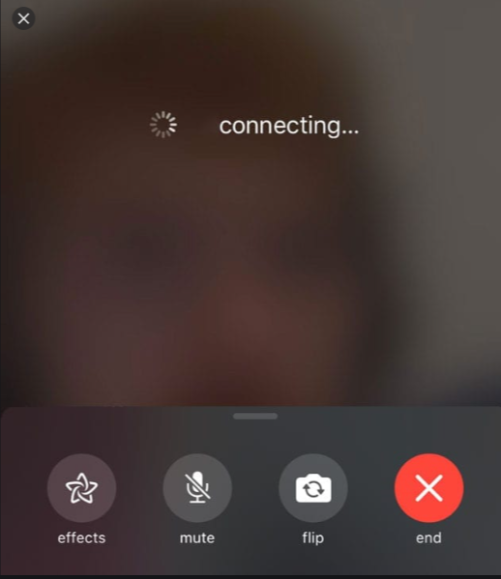
FACETIME
4.)
5.)
HOW TO USE:
4.) This screen will come up next – you have the option on the bottom right to mute
5.) This is what you will see during the patient encounter – you can see the following options:
-Mute
-Flip – what is
behind phone
-End – to end encounter
**You may see ‘paused’ if patient has gone of this screen

Slide 39
FACETIME: HOW TO VIDEO
How to Utilize FaceTime for Patient Encounters:
https://youtu.be/7e_xBkz9p7o

Slide 40
SKYPE
Works on iOS or Android and MAC or PC
Can only display a phone number but you can obtain a new number from Skype to use exclusively with SKYPE/for patient care.
If you don’t want a phone number displayed you can also set up your Skype account to show your work email instead.
Call patient’s number at the time of the appointment
Skype does not have a file sharing feature like Adobe Connect or Duo, but the chat feature is a very easy way to add files.
  If you’ve turned off the chat history feature and you want participants to have access to a file (a workbook, group rules document, etc.), you have to add it to the chat again each time there’s a new member.
  When screen sharing on the computer, it seems to work better through a web browser than through the stand-alone app.

Slide 41
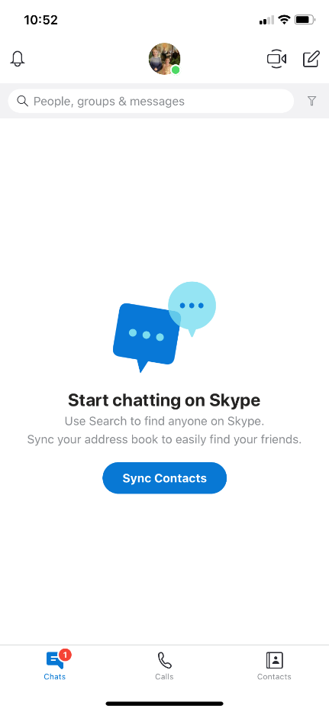
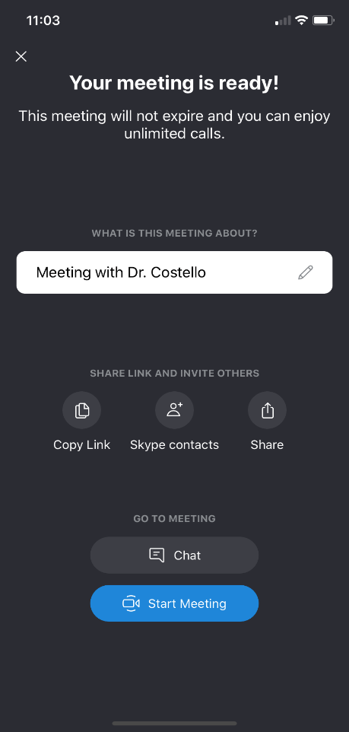



SKYPE
1.)
HOW TO USE:
1.) Click the SKYPE App picture
2.) Three Options to Connect:
- Video Mtg – This creates a meeting and a URL you can send to a patient so they can join the meeting
- New Chat – see next slides
- Search – see next
slides
3.) If you click , you can then click ‘Copy Link’ and paste the link into a message or email to the patient.
Then you can click "Start Meeting."
2.)
3.)

Slide 42
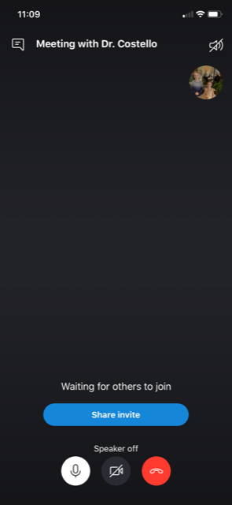
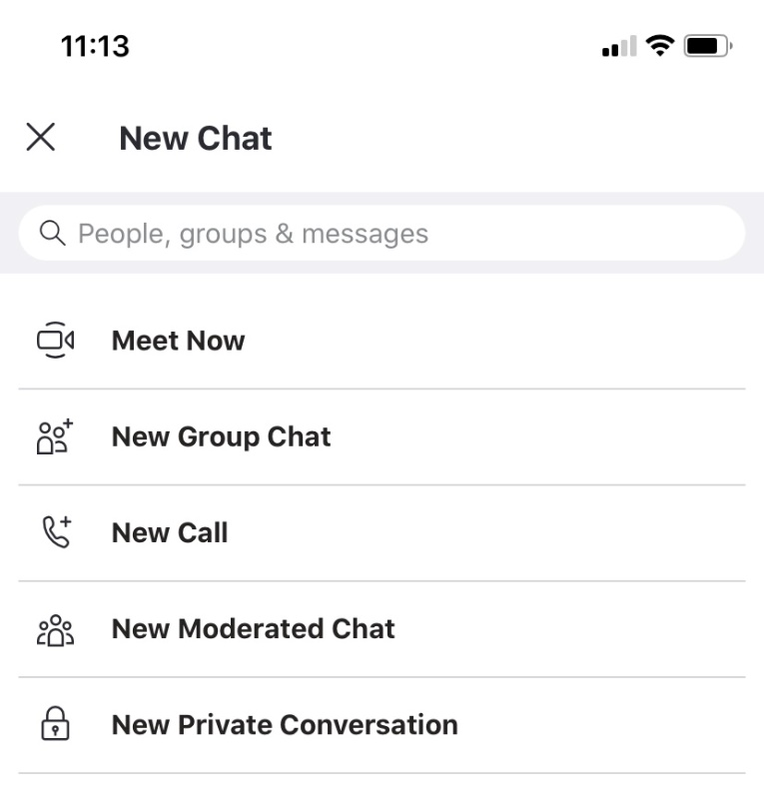

SKYPE
4.)
HOW TO USE:
4.) This screen will come up next – you have the option on the bottom to mute (left), turn off your camera (middle), and end the call (right).
5.) If you click from the #2 screen shot, you get the “New Chat” Options:
-Meet Now, which we discussed on the previous slide
-New Group Chat – can add up to 50 participants
-New Call – can make a call by dialing a phone number using
5.)

Slide 43
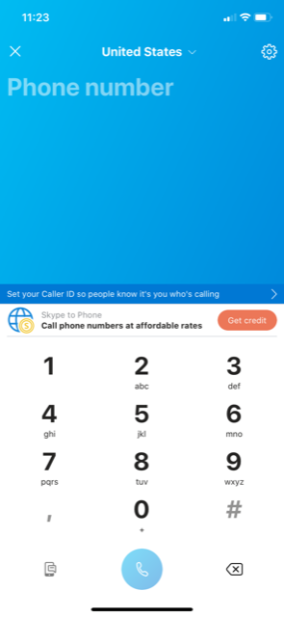
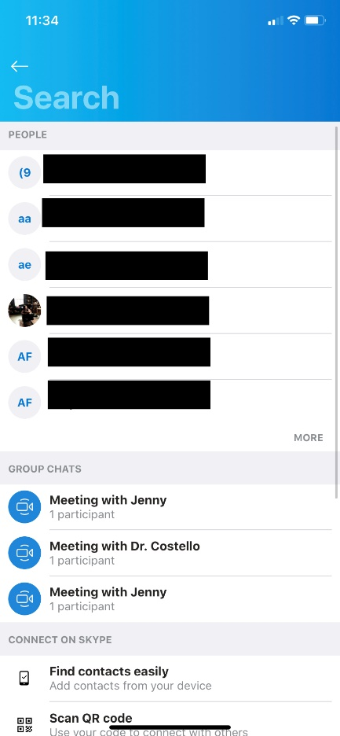
SKYPE
6.)
7.)
HOW TO USE:
6.) This screen will come up next after you press the button. From here, enter the number and press the phone icon to dial.
7.) The function can be used to search for previously dialed numbers.

Slide 44
SKYPE: HOW TO VIDEO
How to Utilize Skype for Patient Encounters:
https://youtu.be/cckvO0Pswko

Slide 45
GOOGLE DUO
Works on iOS or Android and Mac or PC
Must have a Google Account to use
Google asserts the calls are encrypted for privacy
Can only display a phone number, but you can obtain a new number from Google Voice to use exclusively for patient care
Call patient’s number at the time of the appointment
When you dial a patient’s contact info, you will always have the option to either do a voice-only call or a video call
  While clinical encounters should be video-based, if you need to quickly reach a patient to change an appointment time or otherwise initiate a brief call, you can conveniently use either program for voice only.

Slide 46


GOOGLE DUO
Using your desktop:
  Go to duo.google.com, sign into Google with your username and password
  Verify your phone number: enter your regular or Google voice number
  Click “Get Verification code”
  Receive and enter the code
  Click Resend if you don’t receive
Using your laptop:
  Click on
  In the pop-up that opens, enter the number you wish to call, then click on
  OR: Click on one of your contacts listed under “Connect on Duo”
  Chose if you want to make a voice-only call or a video call

Slide 47


GOOGLE DUO
Using your iPhone:
  Download Google Duo app from App store
  Select a listed contact to call, or use the search bar at the top of the screen to either search for a contact or enter a new contact:
    To the right of the search bar, press the and buttons to toggle between 9-key and keyboard
    Enter the contact name/number or new number
  You will then have a choice between voice call, video call, or message
  The Caller ID seen by the patient will be whatever number you have associated with your Google Duo account

Slide 48

Creating an internet-based Google Voice number
To create a Google Voice number, you must have a Google ID and password, then:
Go to voice.google.com
Follow prompts to set up your Google Voice number, which you may use for:
  phone calls to patients using your cell phone
  phone or video calls to patients using:
    Google Duo on your Mac or PC (duo.google.com)
    The Google Duo app on mobile devices
      similar to FaceTime for users with Android phones
      iPhone users can download onto any mobile device using IOS

Slide 49
Setting up Google Voice to send and receive calls and messages
Once you have set up your number on voice.google.com:
Go to “Account” tab on left
Under Google Voice number, see “My devices”
Enter your cell phone and follow prompts to link your personal cell phone number to your Google number
  *Once your cell number is linked to your Google Voice number, you can initiate and receive work-related phone calls from your cell phone
  *The recipient will see your Google number as the caller ID
  Your personal cell number will not be visible to the patient
  Because linking these numbers allows your patients to call your cell phone, it is wise to set clear rules with patients regarding how, when, and why they should contact you.

Slide 50
Linking Google Voice to your phone and email
Continuing on the Account page of voice.google.com, under “My Devices,” see Messages
Select the device where you would like to receive voice messages (i.e. cell phone, computer, tablet, etc).
You can also forward patient voice messages to your personal email account
  *you will receive a Google Voice notification as an email message, but the patient will not have your email address

Slide 51
Google Voice as Caller ID
Under “Messages,” see Calls
Select “Always use my phone to place calls”
If you do not wish your Google Voice number to appear on caller ID, select “Anonymous Caller ID.”
If you leave this unselected, the Caller ID will be your Google number
Incoming calls: if you select both the Web and your cell phone, you can speak with patients calling you using either method
Call forwarding: personal choice

Slide 52
Google Voice message options and
Personal Voicemail Greeting(s)
Set email alerts for missed calls: enter your email address (again, patients will not see this information) for an email to alert you to a missed call
Read “Learn More” for options regarding incoming calls
Select “Show my Google Voice Number as Caller ID when Forwarding Calls” to easily distinguish work-related calls from non-work calls on your personal cell phone
Voicemail:
  Click “Record a greeting” to create a greeting that patients will hear if you do not answer your Google Voice call from the patient
  Can also use this function to set vacation greetings
  Select “Get Voicemail via Email” if you wish to get voicemails this way

Slide 53

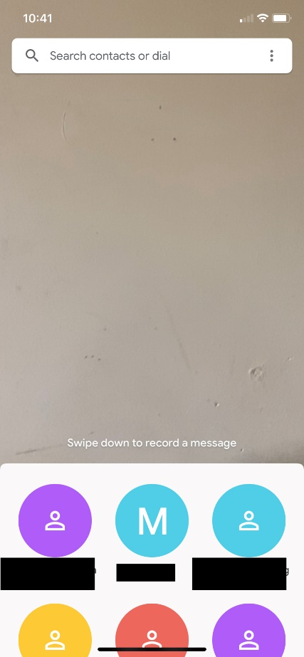
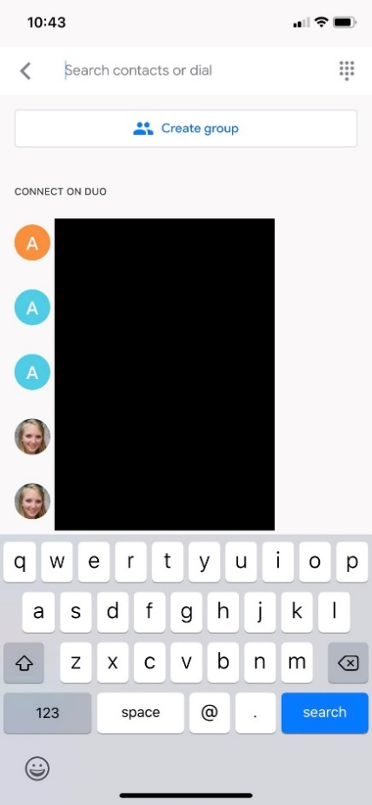
GOOGLE DUO on Phones
1.)
2.)
3.)
HOW TO USE:
1.) Open the Google Duo app (icon)
2.) As discussed on Slide 47 (using Duo on Cell Phones), use the search bar to search for contacts or enter a new contact.

Slide 54
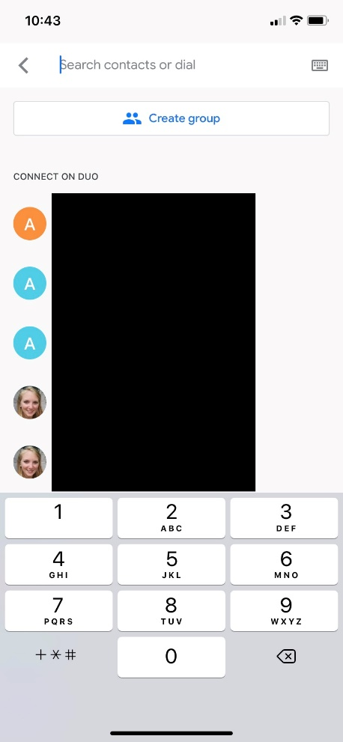
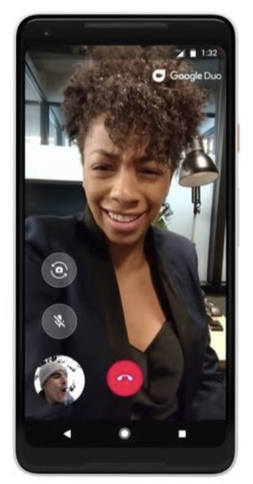



GOOGLEDUO
4.)
5.)
HOW TO USE:
4.) Entering numbers using the dial pad
5.) This is a company stock photo of what an ongoing call would look like
- - flip screen – will
show what is behind
your phone
- - mute
- - to end the meeting

Slide 55
GOOGLE DUO: HOW-TO VIDEO
How to Utilize Google Duo for Patient Encounters:
https://youtu.be/nVOEpkmDU8o

Slide 56
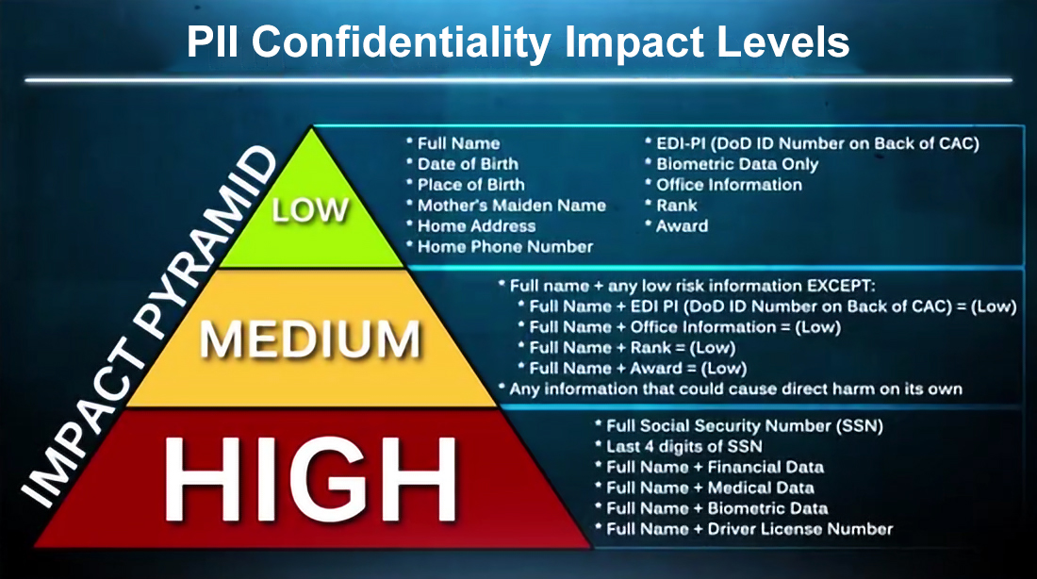
MS TEAMS
Recently approved for patient interactions
  ONLY LOW-IMPACT PII IS AUTHORIZED.

Slide 57
MS TEAMS
Scheduling the visit:
  If Administration Schedules Visit:
    Places burden of meeting management and patient communication on administrator.
    TIP: Specific staff who set meeting should be on duty during date/time of appointment in case adjustments are necessary.
  If Provider Schedules Visit:
    Places burden of meeting management and patient communication on provider.
    Allows provider to quickly change date/time and add participants without requesting assistance from others.
    TIP: Include administrative staff on meeting invite to give access to meeting URL in case patient seeks administrative assistance.

Slide 58
MS TEAMS
Scheduling Tips/Initiating the Meeting:
  Obtain patient’s email address and phone number.
  Explain that patient will be able to access Teams “meeting” from mobile device or computer.
  When possible, send meeting invitation while in contact with patient to ensure receipt and to answer questions.
  Use separate “meeting” for every patient encounter.
  Do not use any personal identifies in the Teams calendar. Instead, use “Dr. Smith, Patient 1” or another clinic-wide method.
  Only individual who sets the meeting can adjust the date/time or add additional participants.

Slide 59
MS TEAMS
Initiating the Visit:
  Do:
    Begin every visit by verifying participant’s:
      Full name
      Date of birth
      Current physical location – May be different from home address.
      Patient’s call-back number in case of connectivity issues.
    Gain verbal consent to use Teams for patient care.
    Assess privacy of patient’s environment.
  DO NOT:
    Allow calls from a blocked number.
    Use the recording feature.
    Use the chat feature.

Slide 60
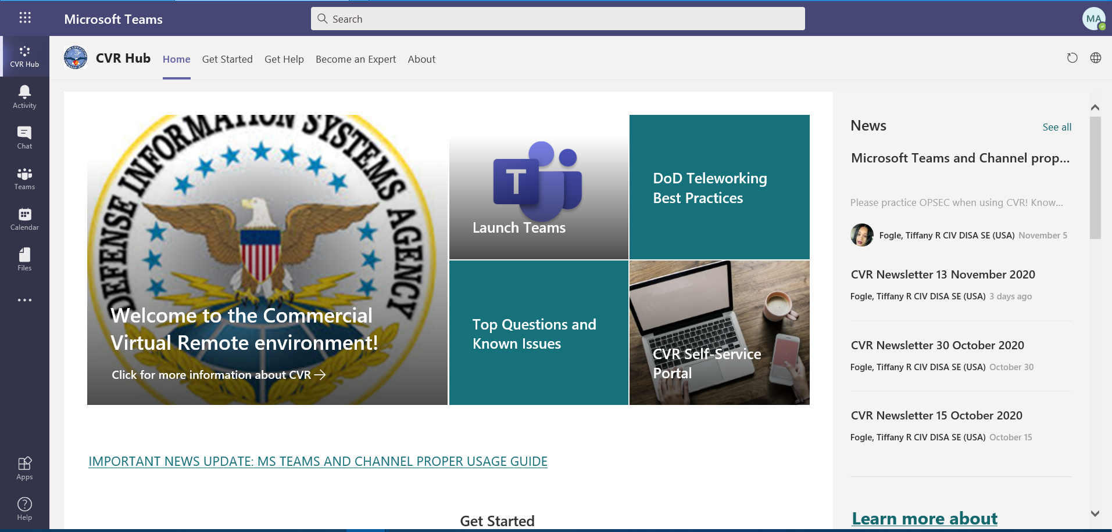
MS TEAMS - Training
Once logged in click on “CVR Hub” (Blue Arrow).
Click on “Get Started” (Red Arrow).

Slide 61
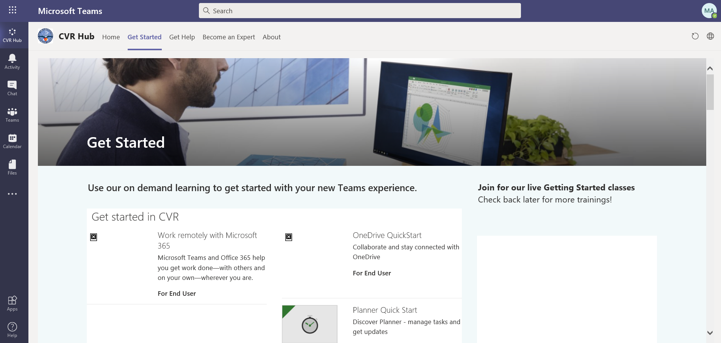
MS TEAMS
This webpage has videos and step-by-step instructions for various activities in MS Teams.
  Scroll down to see various topics.

Slide 62
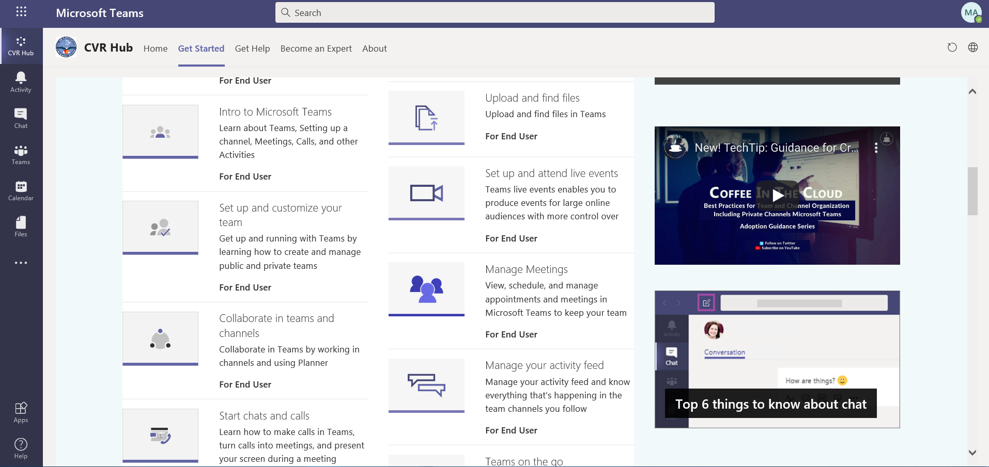
MS TEAMS
Click on “Manage Meetings” (Blue Arrow)

Slide 63
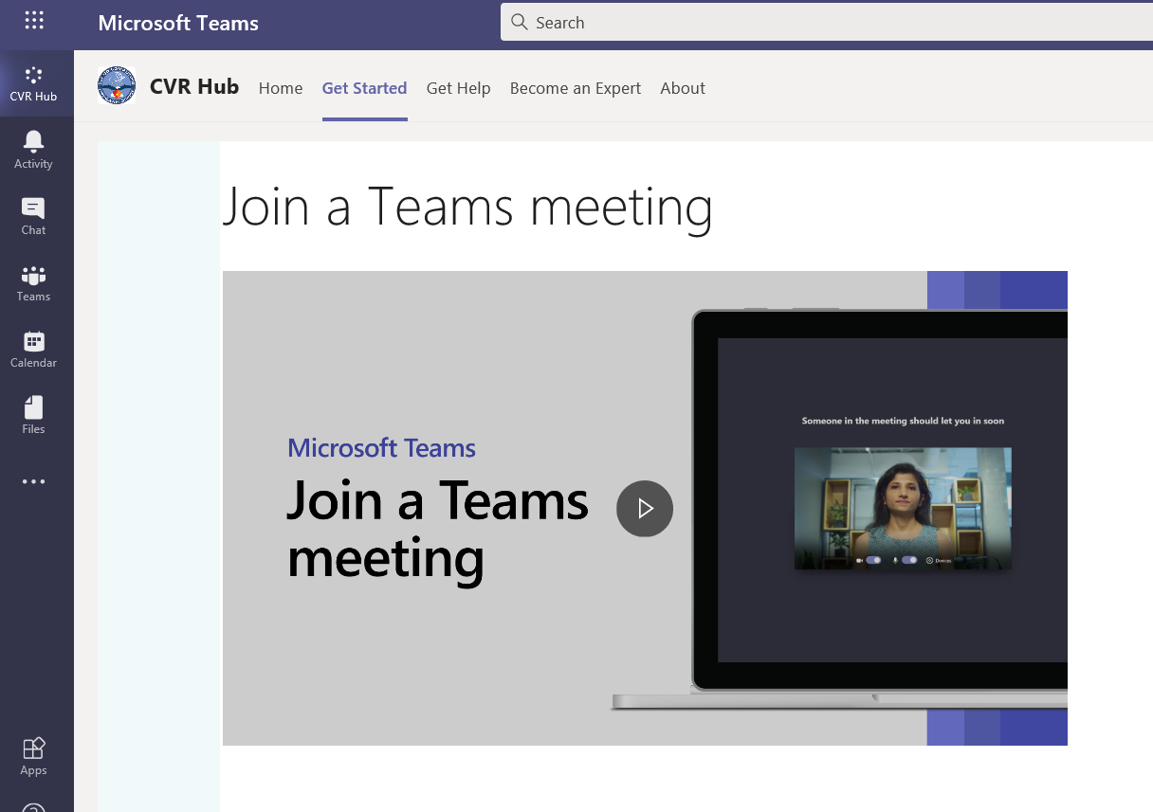
MS TEAMS
There is a video for you to review and step-by-step directions if you scroll down.
  Join a Microsoft Teams meeting from your calendar or sign in as a guest on the web.
    Join a Teams meeting from the app
      From you Calendar, select Join on an in-progress meeting.
      Choose the audio and video settings you want.
      Select Join now.
    Join a Teams meeting on the web
      Don't have the Teams app? You can still join a Teams meeting.
      In your email invite, select Join Microsoft Teams Meeting.
      You can also use a dial-in number and conference ID from the email to call in.
      You have two choices:
        Download the Windows app: Download the Teams app.
        Join on the web instead: Join a Teams meeting on the web.
      Type in your name.
      Choose the audio and video settings you want.
      Select Join now.
      Depending on meeting settings, you'll get in right away, or go to a lobby where someone in the meeting can admit you.

Slide 64
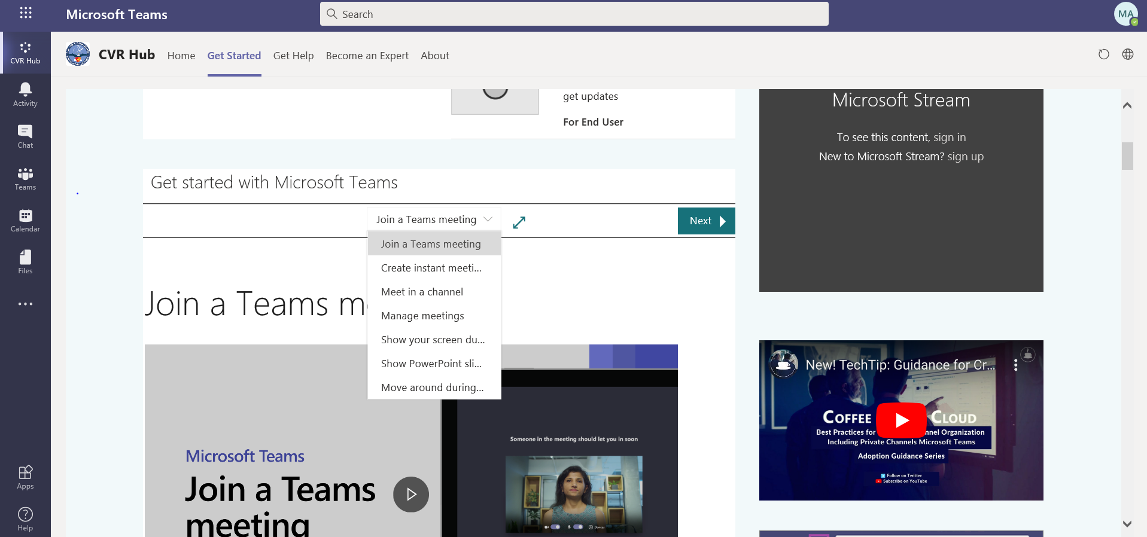
MS TEAMS
If you scroll up, you will see a Menu Bar
When you click on the Menu Bar, you will see a list of options for tutorials.

Slide 65
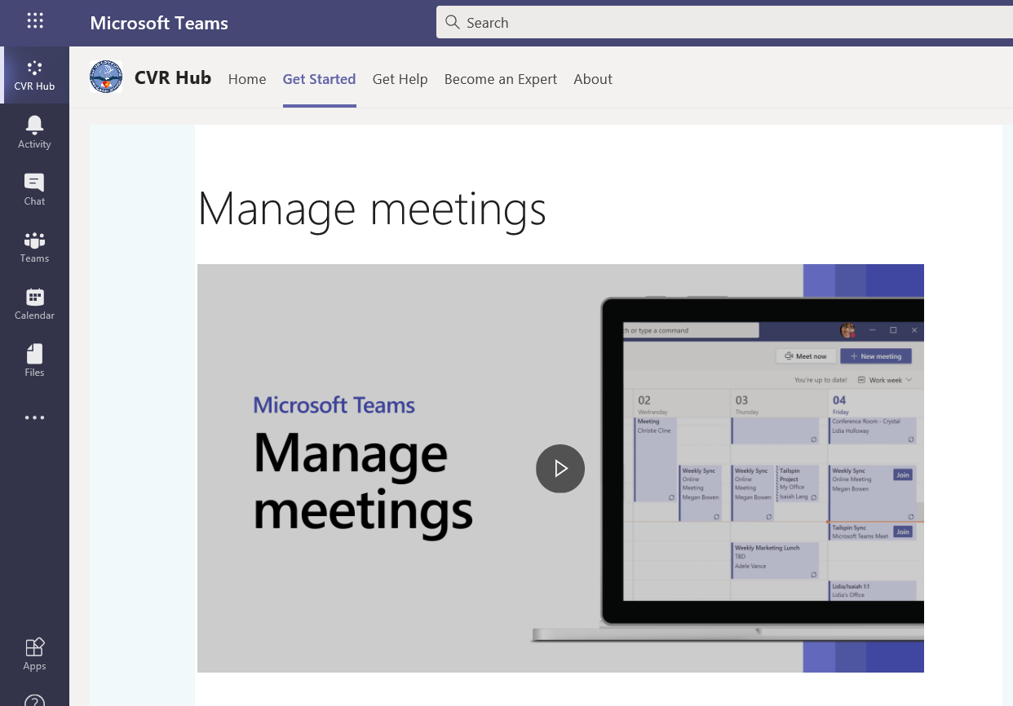
MS TEAMS
You will see the following screen when you click on “Manage Meetings”
  View, schedule, and manage appointments and meetings in Microsoft Teams to keep your team on track.

Slide 66
MS TEAMS
You will see the following screen when you click on “Manage Meetings”
  View, schedule, and manage appointments and meetings in Microsoft Teams to keep your team on track.
    View meetings
      Select Calendar to view your appointments and meetings for the day or work week.
      These appointments stay synchronized with your Outlook calendar.
      Select a meeting invite to see what the meeting's about, who's attending, and to respond to the meeting.
    Schedule a meeting
      Select New meeting.
      Type in a meeting title and enter a location.
      An online meeting is created by default.
      Choose a start and end time, and add details if needed.
      Enter names in the Invite people box to add them to the meeting.
        Note: To invite someone outside your organization, type in their email address and they'll get an invite to join as a guest — even if they don't have Microsoft Teams.
      See everyone's availability in the Attendees list and, if needed, choose a suggested time or select Scheduling assistant to see more available times in a calendar view.
      Under Select a channel to meet in, select the drop-down arrow to manage your meeting's privacy settings:
      Select None to keep your meeting private.
      Select a channel to open the meeting to team members.
      If your meeting gets posted in a channel, it'll appear under the Posts tab. Team members can set agendas, share files, or add comments.

Slide 67
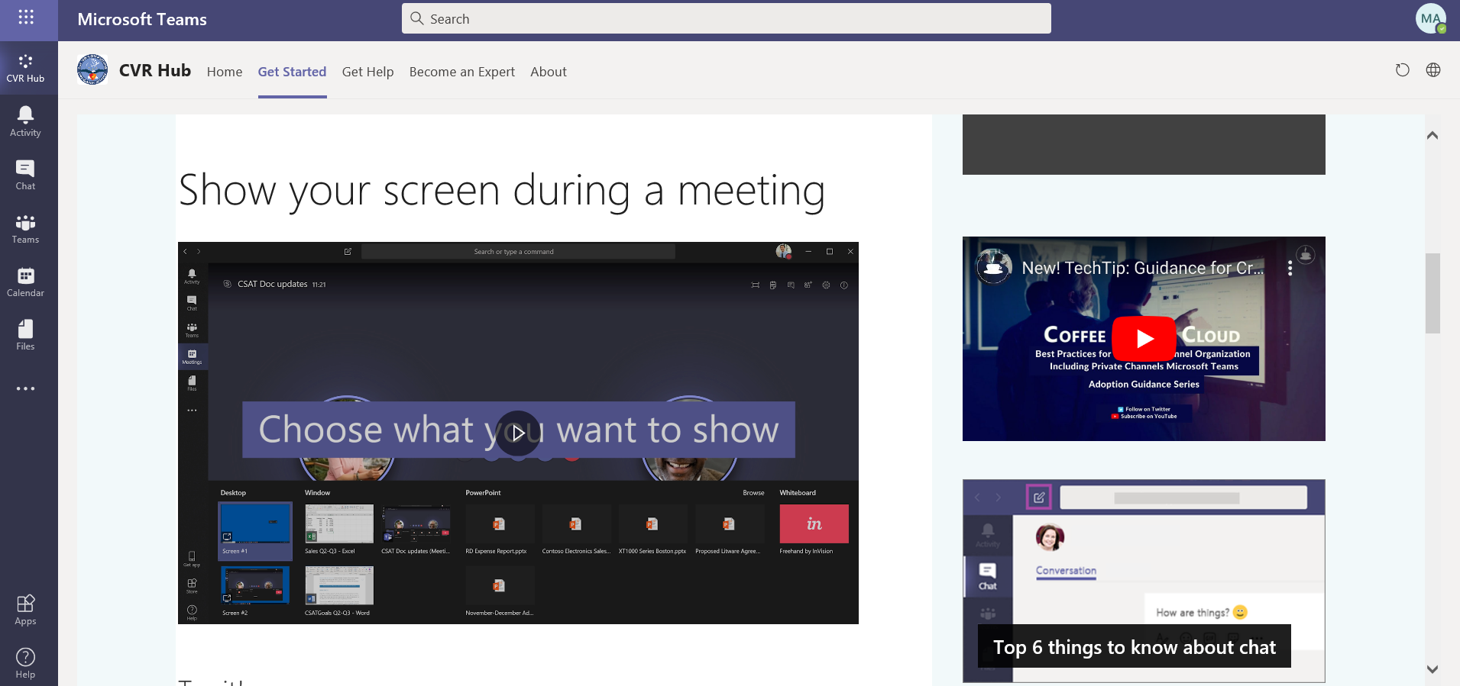
MS TEAMS
You will see the following screen when you click on “Show Your Screen During a Meeting”
  In Microsoft Teams, you can show your desktop, a specific app, presentation, or any file while in a meeting.

Slide 68
MS TEAMS
You will see the following screen when you click on “Show Your Screen During a Meeting”
  In Microsoft Teams, you can show your desktop, a specific app, presentation, or any file while in a meeting.
    1. Select Share Share screen button.
    2. Select what you want to share:
      Desktop lets you show everything on your screen.
      Window lets you show a specific app.
      PowerPoint lets you show a presentation.
      Browse lets you find the file you want to show.
    3. After you select what you want to show, a red border surrounds what you're sharing.
    4. Select Stop sharing to stop showing your screen.

Slide 69
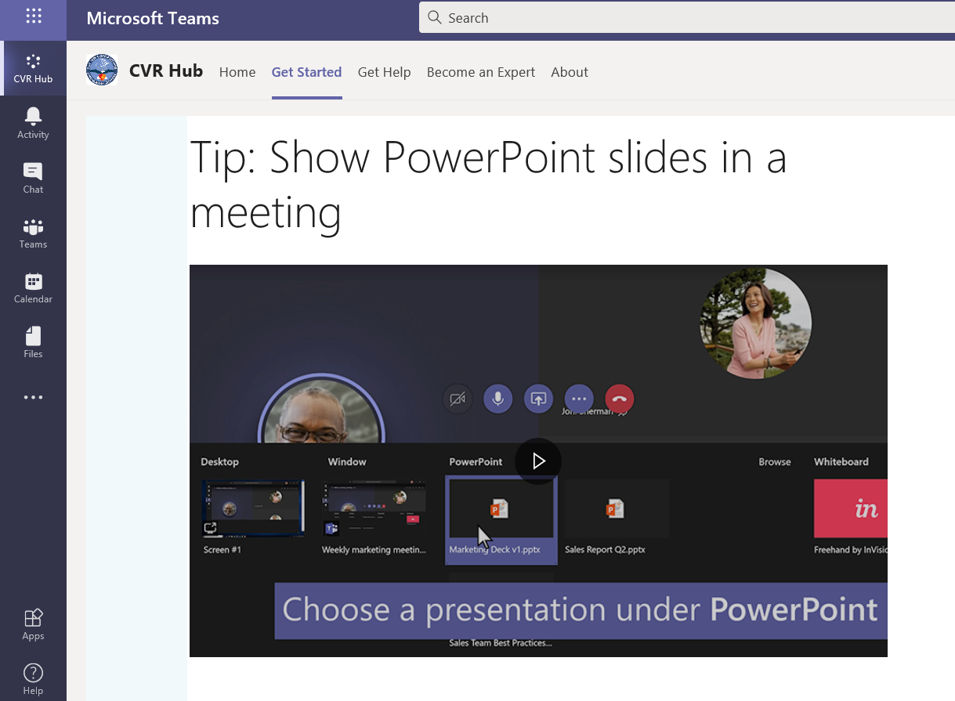
MS TEAMS
You will see the following screen when you click on “Show PowerPoint Slides in Meeting”

Slide 70
MS TEAMS
You will see the following screen when you click on “Show PowerPoint Slides in Meeting”
  If you need to present in an online meeting, show your PowerPoint slides right from the Microsoft Teams meeting menu.
    If you're a presenter
      Select Share.
      Choose a presentation under the PowerPoint category.
    If you're a meeting participant
      Select Navigate forward to move forward in a presentation without interrupting the presenter.
      Note: The presenter must share the file from the PowerPoint category in order for participants to skip around during a presentation.
      Select To presenter to sync your view back to the presenter's when you want.

Slide 71
CODING
Coding for full tele-BH encounters:
  Enter encounter as an FTR TELMED or a SPEC TELMED (as applicable)
  Document time spent on therapy and E&M at top of note
  In the A/P module, document CPT codes as you would a normal face-to-face encounter
  In the Disposition module:
    Prescribers should select the appropriate E&M code just as they normally would (unless doing therapy only), and non-prescribers should select 99499 or leave it blank.
    Click on the arrow to the right of ‘Modifiers.’ Scroll and select ‘95.’ This indicates it is a tele-health encounter, either from MTF-to-home or from home-to-home. If there is a connection problem and the provider completes the encounter by phone, the encounter should still be documented using the 95 modifier.

Slide 72
CODING
Coding for full tele-BH encounters:
  Non-prescribers should also be adding the modifier 95 but not in the same place as prescribers.
    For non-prescribers, modifier 95 should be added in the A/P section of the note by clicking on the procedure CPT code (90837 for individual and 90853 for group) and then adding 95 there.
    For an IOP session, which applied to only some clinics and providers, the system will not allow you to add modifier 95 to a S9480 procedure code.
      Instead it should be added in the Disposition section following the same instruction as prescriber (see previous slide).

Slide 73
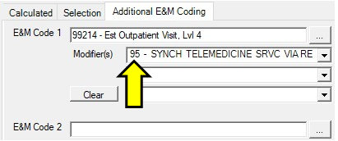

CODING
For Full (Audio/Visual) Tele-BH Encounters:
For Provider-to-Location-other-than-MTF, i.e. MTF-to-Home or Home-to-Home (95 modifier):
For MTF-to-MTF (GT modifier):

Slide 74
CODING
Coding for Audio-only encounters require the same procedures and consents as full tele-BH encounters:
  Encounter should be entered as an FTR TELMED (not a T-CON)
  Document time spent on therapy and E&M at top of note
  In the A/P module, enter the CPT code you would usually enter with a face-to-face encounter, then click on the HCPCS radio button and enter the CPT code T2025
  In the Disposition module, prescribers should select the appropriate E&M code as they normally would (unless doing therapy only). Non-prescribers should select 99499 or leave it blank.

Slide 75

CODING
For Telephonic (Audio-Only) Encounters: HCPCS code T2025

Slide 76
TELEWORKING TIPS
Managing Screen Exposure Hazards:
-Potential hazards include:
-Ocular migraines
-Blurry vision, headaches
-Fatigue
-Sleep Disturbances
-Blue Light:
-Blue light can affect your sleep and lead to changes in the
circadian rhythm
-Reduce exposure at night to improve sleep:
-Use dim red lights for night lights
-Avoid looking at bright screens for 3 hrs before bed
-Consider blue light blocking filters or glasses

Slide 77
TELEWORKING TIPS: MAYO CLINIC
Blink often to refresh your eyes.
  -Many people blink less than usual when working at a computer, which can contribute
  to dry eyes. Blinking produces tears that moisten and refresh your eyes. Try to make it
  a habit to blink more often when looking at a monitor.
Take eye breaks.
  -Throughout the day, give your eyes a break by looking away from your monitor. Try
  the 20-20-20 rule: Every 20 minutes, look at something 20 feet away for at least 20 seconds
Check the lighting and reduce glare.
  -Bright lighting and too much glare can strain your eyes and make it difficult to see
  objects on your monitor.
  -The is worsened from sources above or behind you, including fluorescent lighting
  and sunlight.
  -Consider turning off some or all of the overhead lights.

Slide 78
TELEWORKING TIPS – MAYO CLINIC
Adjust your monitor. Position your monitor directly in front of you about an arm's length away so that the top of the screen is at or just below eye level. It helps to have a chair you can adjust too.
Use a document holder. If you need to refer to print material while you work on your computer, place it on a document holder. Some holders are designed to be placed between the keyboard and monitor; others are placed to the side. Find one that works for you. The goal is to reduce how much your eyes need to readjust and how often you turn your neck and head.
Adjust your screen settings. Enlarge the type for easier reading. And adjust the contrast and brightness to a level that's comfortable for you. Some monitors have a “night mode” that changes to a low blue-light setting at a scheduled time every day.

Slide 79
TELEWORKING TIPS
Ergonomics and Supplies
  Essentials
    Dedicated office space, comfortable computer chair, a desk at the height that works for typing, wrist position, and allows for healthy eye distance from computer screen(s)
    Room and desk lighting, along with natural lighting if possible
    Easily accessible, organized supplies: pens, pencils, paper clips, post-it pads
    Phone rosters, alter roster, easily accessible hard copy note template, hard copy inventories/questionnaires, scoring sheets
    Hard copy notebook, easily referenced calendar, easily accessible device chargers

Slide 80
TELEWORKING TIPS
Work Flow
  Optimal work flow processes results in:
    improved time management
    increased productivity
    reduced stress with work more likely to be completed before suspense dates
    increased job satisfaction and feelings of accomplishment
Organizing the work area so as to integrate physical space and available resources (devices, accessories, supplies, etc.) with systematized processes reduces mental clutter and wasted time

Slide 81
TELEWORKING TIPS
When teleworking with either a personal laptop/desktop or a government laptop, Citrix may not easily interface (often cannot access the camera and/or the microphone)
This means that when on the virtual desktop, connectivity with Team or Adobe Connect can be compromised, or, if using FaceTime or Google Duo for virtual appointments, a second computer is often necessary
If so, it becomes necessary to create a system of interface between the two devices, as well as a third device if a cell phone is used for Google Duo or FaceTime

Slide 82
TELEWORKING TIPS
Set up an organized contact list of your patients so you can easily access it on either FaceTime or Duo. Consider using initials only.
If you take notes electronically (vs. pen and paper) during patient encounters using a computer:
  Consider sizing the FaceTime or Duo screen so as to be side by side with a note taking app (Apple Notes, Microsoft OneNote, etc.)
  Consider having a separate keyboard (Bluetooth or wire attached) that will allow you to take notes further from the device, thus reducing interruptive typing noise

Slide 83
TELEWORKING TIPS
If you take notes electronically during patient encounters, consider the following for FTR encounters:
  Keep session notes brief, using bullet style key phrases to prompt yourself for reference in writing the encounter note
  When taking session notes electronically, do not use any identifying information and be highly generalized, for example: “discussed peer relationships,” or, “explored coping with stress.”
  These generic references can prompt you as to the specifics of the session when writing the note later in AHLTA
For note taking during intakes/SPEC encounters: either hand- write or type directly into AHLTA or Word

Slide 84
TELEWORKING TIPS
Well-designed encounter templates are administratively and clinically essential
Does your service have standardized encounter templates? If so, do you have suggestions for design improvements that will:
  improve the note clinically
  reduce repetition or unnecessary content
If your service is not yet using standardized templates, consider designing your own, trying it out, tweaking it and sharing with leadership and colleagues. Be open to edits, suggestions and changes… a collaborative process with creative brainstorming benefits everyone!

Slide 85
TELEWORKING TIPS
Copy forward is both friend and foe. Our last Joint Commission surveyor advised against it:
  Outdated information often gets repeated
  Important information, such as mental status, may be incorrectly documented
  Treatment plans may not be reviewed or updated, reducing the clinical validity of the note
  *These issues raise ethical and liability concerns
Suggested workaround: build a strong first FTR note after your SPEC. Then if you use copy forward (or more specifically, if you select, copy and paste a previous “Add Note” into the current encounter):
  Identify components of the note that must be session specific, then follow up diligently in subsequent notes
  Establish a practice of reviewing the entire note critically before signing, be sure it’s current and reflective of the encounter that day
If you use the foundation of a previous note it can be a time saver, provided you update diligently!

Slide 86
TELEWORKING TIPS
CONFIDENTIALITY:
-For groups, the chat feature is very useful but also poses confidentiality concerns, as usernames and chat comments are visible in the chat indefinitely.
-If you use the same group link for a rolling group, new participants will likely be able to see the usernames and chat comments of anyone who was previously in the group.
→Two ways to address this; it’s most effective if both are implemented:
1.) Directly comment on this feature to new group members, and
encourage them to change their usernames to something non-
identifying if they’re concerned about this.
2.) Once you create a link to a group, you can open up the group
settings and de-select “Chat History” which will hide the chat to new
participants. This feature is available in Skype.

Slide 87
TELEWORKING TIPS
BOUNDARIES:
-Sessions using Skype and other applications may not have defined start and end times like CMS.
-Without start and end times, patients can access the link and start a call or chat at any time, and everyone in the group will get a notification on any device they’ve used for the group.
→Four suggestions for this:
Directly address this issue when discussing group expectations, remind patients of other emergency resources, and make the expectations clear regarding when and how to use the link.
Encourage patients (and other clinicians) to turn off notifications within their Skype account so they don’t receive alerts if they don’t wish to.
Sign out of Skype at the end of your work day (especially useful for clinicians).
Remove patients from the group/team when they have graduated from or have otherwise completed the group.

Slide 88
TELEWORKING TIPS
Suggested Group Rules:
    Group members will ensure they are in a private location with little potential for outside individuals (including children) to overhear or oversee group activities; the use of headphones is preferred.
    It is the responsibility of all group members to protect the privacy of other members; if someone enters their private location, they are required to inform the group.
    Members are expected to participate in full audio/video mode unless the group is strictly educational in nature, in which audio-only is acceptable. If a group member loses their video connection, the facilitator will pause group discussion until the member re-establishes their video feed or (if this does not appear likely) until the group makes a decision about whether or not to proceed without it.
    Group members must be dressed appropriately during sessions; the facilitator reserves the right to dismiss any group members with inappropriate attire.
    Patients may not be driving, shopping, cooking, or otherwise distracted while participating in virtual group therapy.
    Failure to comply with group rules may result in removal from the group. If participation is required by regulation, the members’ command or supervisor will be informed.

Slide 89
TELEWORKING TIPS
Groups
  Group cohesion and psychological safety are best enhanced when everyone can see each other. The facilitator may choose to make some rare exceptions if having the camera on poses a genuine clinical issue for the patient’s anxiety, or if a patient is joining from a workplace that does not allow camera use, although facilitators should emphasize the expectation that cameras are on and participants are visible in the vast majority of situations.
  Group members may often drop in and out due to poor connection, and it is infeasible to stop every time this occurs. Someone leaving angry or immediately following a vulnerable disclosure may represent deliberate behavior and should raise concern. For this reason, having a co-facilitator (ideally a BH tech) is ideal when possible, as one facilitator can leave the group to check on the patient while the other continues running the group.

Slide 90
TELEWORKING TIPS
Audio-Video Troubleshooting:
-Briefly turning off the camera can help if reception is getting choppy
-If the patient can see you but not hear you if can help to:
1.) Leave the call
2.) Call back as audio only (using the phone icon), then turn the camera on

Slide 91
TELEWORKING TIPS
The Encounter Itself
  Though it feels unnatural/uncomfortable – try as much as possible to make eye contact with the camera and not the eyes of the person on the screen.
  All telehealth notes should include the language: “The patient has been informed about the benefits and limitations of care delivered via virtual health. The patient understands they reserve the right to in-person care but elects VH today verbally. Provider confirmed patient is located at <address> and is available at <phone number> in case of A/V connection problems or emergency.”
  If it’s a phone-only session, the end of the second sentence should read “but elects audio-only VH today verbally,”

Slide 92
TELEWORKING TIPS
Groups
A couple of minutes reviewing group expectations with a new group or when a new member joins the group is usually time well spent. This includes:
  The formal rules of the group
  Asking people to mute their mics when not speaking.
  For larger groups, you may want to make use of the “raise hand” feature available on some telehealth platforms so the facilitator can call on participants, though with smaller or more cohesive groups this may actually impede the natural flow of discussion.
Tips to Consider for Increasing Engagement:
-Consider a set of check-in questions that everyone answers at the
beginning of a process group, perhaps asking volunteers to read
something aloud if applicable, or simply calling by name on someone
who hasn’t spoken recently – these simple techniques have seemed
a little more useful in the virtual environment than they might be in
person.

Slide 93
TELEWORKING TIPS
Mindset
These platforms are not going to work perfectly. When problems occur, we may either choose to get flustered, anxious, or annoyed, or to accept it flexibly:
  Try to muddle through the best you can, knowing that everyone is having the same challenges (including patients, who can be surprisingly understanding)
  Fall back on an old-fashioned phone call for the duration of the encounter
  Switch to a different platform
Patients are generally not expecting flawless technology; they’re looking for an outlet, some help, and human connection in a time of unprecedented isolation and anxiety.
  Of course this is not an argument for lowering our standards, but rather a case for modeling the acceptance and adaptability that we’re trying to help our patients find.
  Doing “the best you can,” even when glitchy and imperfect, is actually a really big deal right now.
Your skills are valuable, helpful and needed during this time, but you are not an infinite resource. Be kind to yourself, particularly in the face of technology glitches.

Slide 94
RESOURCES
Virtual Medical Center website:
  https://info.health.mil/army/VMC/Pages/Home.aspx
Adobe Connect team:
  VMC-FO IT Team: usarmy.jbsa.medcom-bamc.mbx.dha-jbsa-vmcimd-support@mail.mil”
For MS Teams:
  Army Enterprise Service Center 1-866-355-2769
    For Password resets
DHA Virtual Health Program Link:
  https://info.health.mil/sites/Markets/ncr/co/chio/VHP/SitePages/Home.aspx

Slide 95
RESOURCES
Mr. Sam Regmi: Senior Clinical Engineer – IT support for Adobe Connect or Virtual Health issues
  Call or Email Mr. Regmi for Adobe Connect or Virtual Health Issues
    301-385-0978
    samrakshak.s.regmi.ctr@mail.mil
Ms. Wendy Baynard: NCR Program Manager for Virtual Health
MAJ George Johnson: WRNMMC Chief Medical Information Officer (CMIO) and Virtual Health Lead
LCDR Christopher Cox: WRNMMC Telebehavioral Lead

